Slide 1


Extraordinary Conference of the Parties 2026
9 March 2026

Slide 2
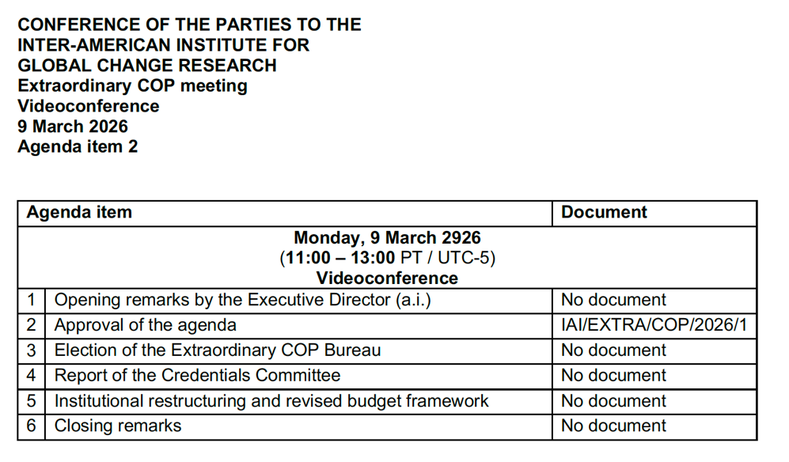

Slide 3
Science Program
Laila Sandroni
Matías Mastrangelo
Daniella Guerrero
Daniel Pinillos
Larisse Faroni
Omar R. López

Slide 4
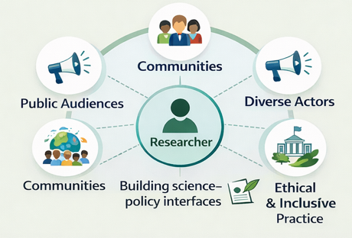

Transdisciplinary Academy: The cornerstone of the Science Program
The Problem
The Solution
Strong Disciplinary Expertise but limited training in:
Working with diverse societal actors
Equity, Diversity and Inclusion
Science Policy Interface
Science communication
Ethics of working with vulnerable communities

Slide 5
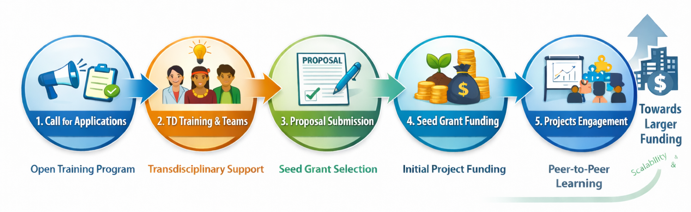
Transdisciplinary Academy Implementation Model

Slide 6
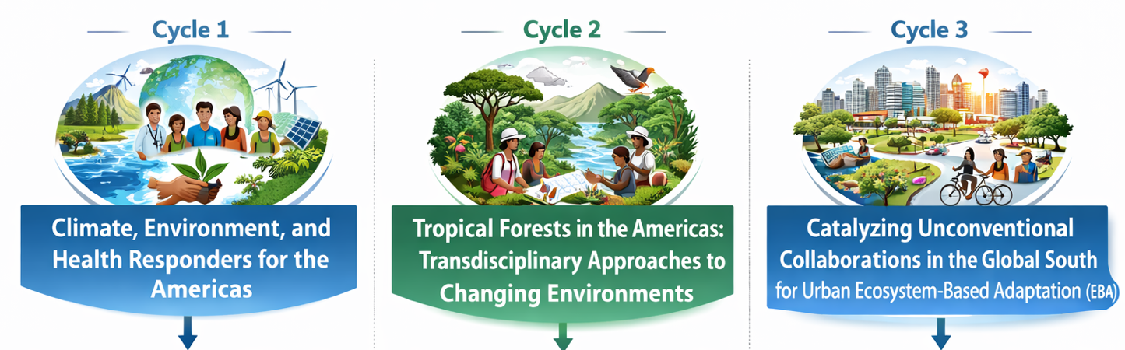
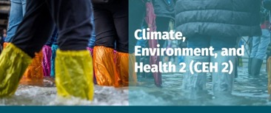







Slide 7
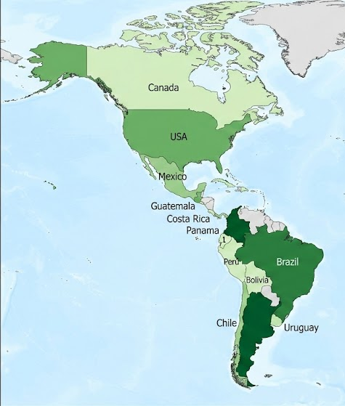
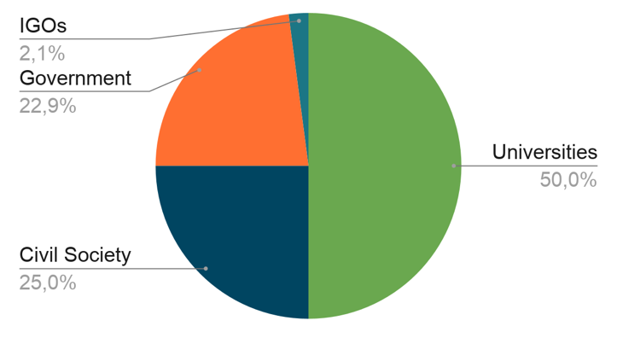
25 Projects
15 Countries
358 People Trained
200+
Hours
96 Institutions
$527.380 USD Funded
$776.231 USD Co-Funding

Slide 8

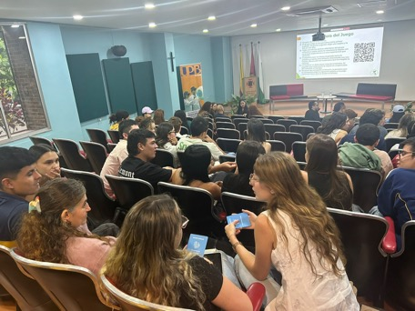
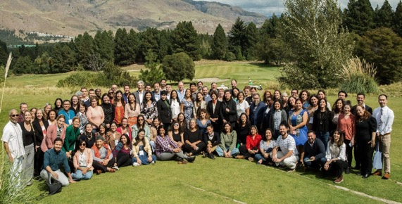
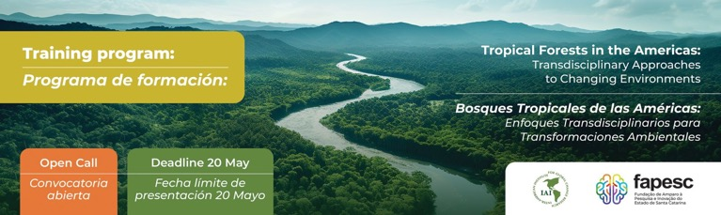
In-Person and Online Engagement

Slide 9















Partnerships and Networks
SAC SPAC IPAC

Slide 10
Implementation of open access to research data and publications
Data and information end-users in IAI member countries
Projects and programs of the IAI
IAI open science infrastructure and management
Production of research data
Thematic collections of databases at Harvard Dataverse
Public and private decision-makers
OPEN ACCESS
Publication of research results and policy recommendations
Repository of articles and reports in IAI website
Science-policy community

Slide 11


Aggregation of open access publications to regional repositories
IAI repository of open access publications
SENACyT repository of environmental research data
La Referencia repository of open access publications for Latin America and the Caribbean

Slide 12
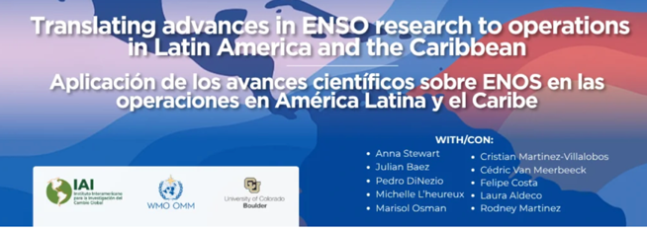
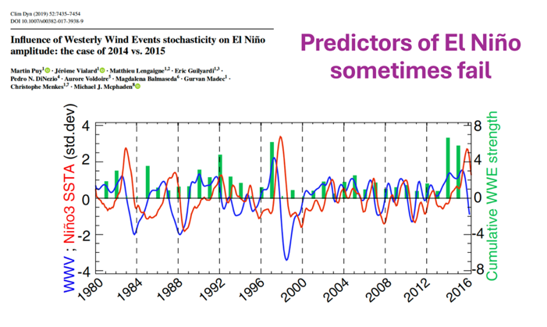
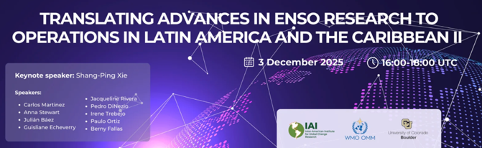
Climate Science in the Service of the Region
> 3.000 inscritos

Slide 13

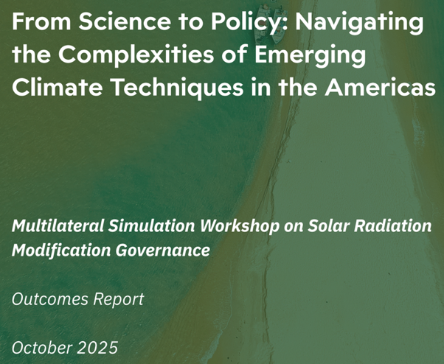


Amplifying LAC voice on the Governance of Emerging Climate Techniques
Participation of 13 Parties

Slide 14
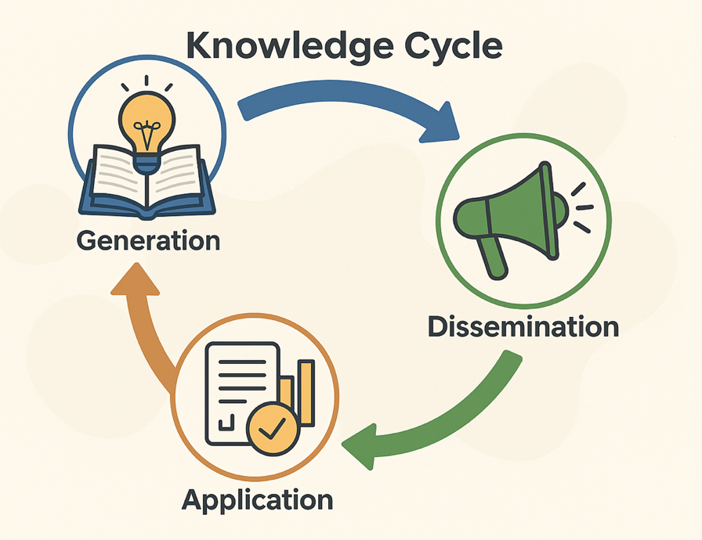
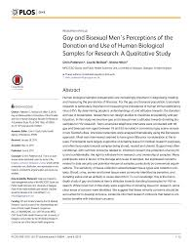
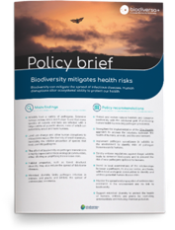


Science for better decision making

