Slide 1

Science Diplomacy Center & STEP Fellowship Program
Marcella Ohira, Deputy Executive Director and Director of the Science Diplomacy Centre (SDC)
Kim Portmess, STeP Programme Leader
Claudia Alarcón, STeP Fellow, SDC
Gabriela Ferreira, STeP Fellow, SDC

Slide 2

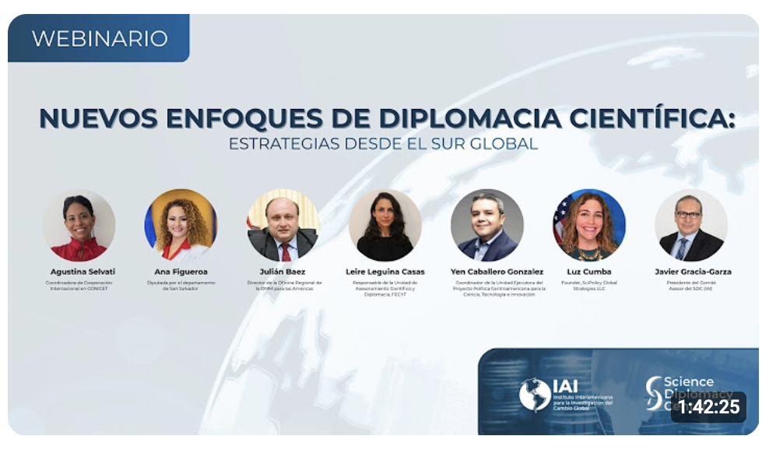
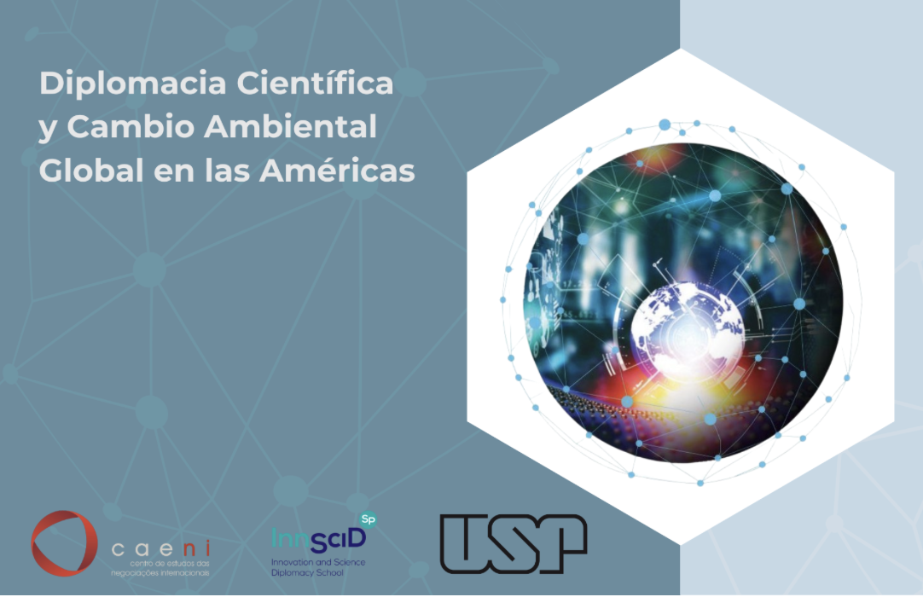
8 JAN 2026
Science Diplomacy Course
Self-paced online course: 17 case studies from the Americas
Webinar presentation: December 2
Videos: Decision Makers, IAI Countries
1,736 views
SD course launch webinar (in ES)
4 thematic modules
2 simulation games
17 case studies from the Americas
3 languages: Spanish, English, and Portuguese
Co-developed with the University of São Paulo - Brazil
680 participants
Total ES, EN, PO.
Notes:
Español: 487
Inglés: 188
Portugués: 5

Slide 3


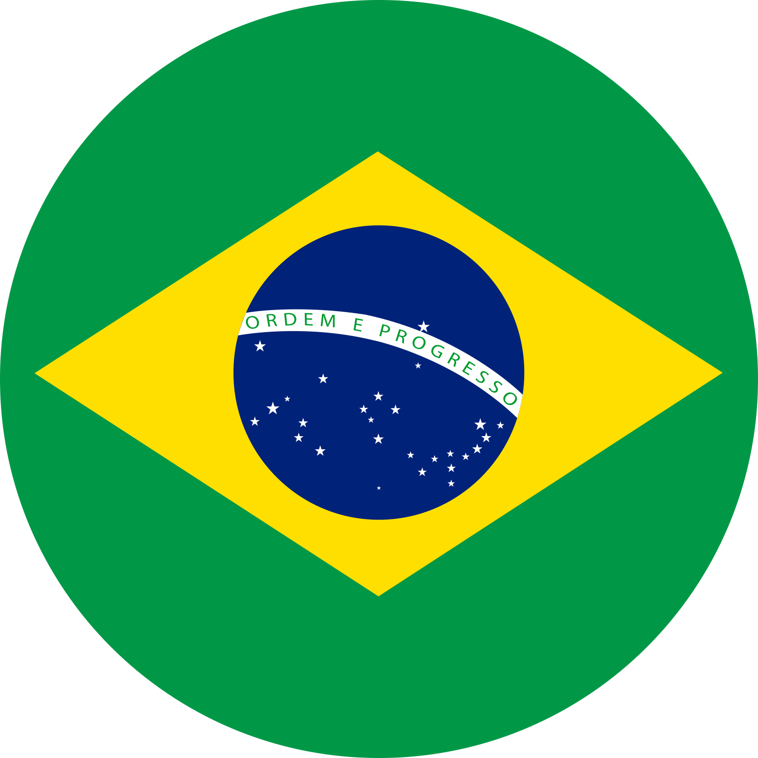
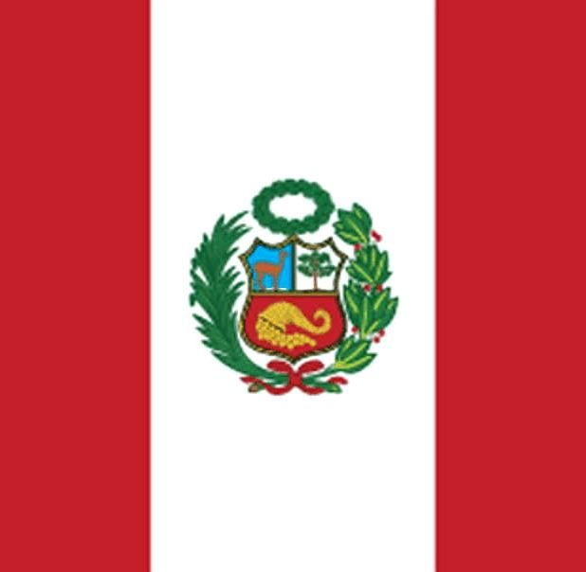
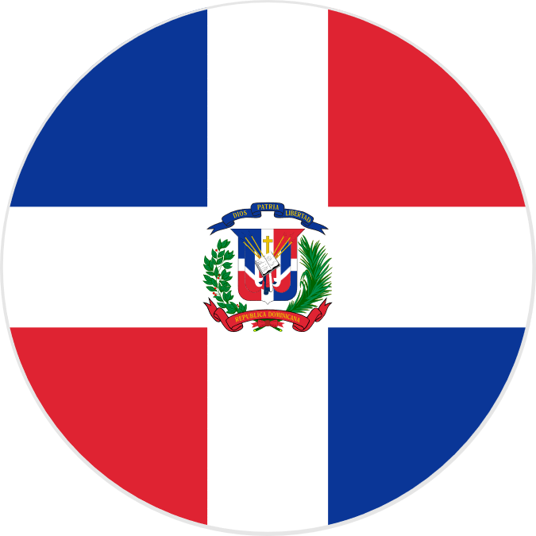

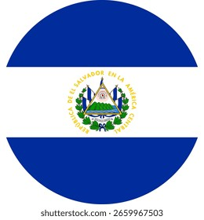

8 JAN 2026
Science Diplomacy Workshops
160 participants
Total Brasil and El Salvador
Scientific Diplomacy Events Co-organized with National Representatives of Parties and Associates
Panama
Paraguay
Brazil
Peru
Dominican Republic
2023
2024
2025
2026
Panama
EUA
El Salvador
UNCCD

Slide 4

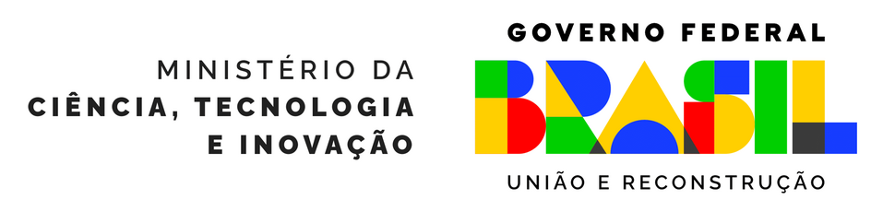

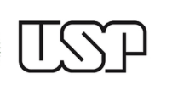


Brasil Workshop (5-7 August 2025):
“Science Diplomacy for Sustainable Development"
SDC Science Diplomacy Workshop
USP School of Science Diplomacy
Science Diplomacy for Sustainable Development in the Americas
2 Coordinated Events
Road to UNFCCC CoP30
Collaboration between government, academia, the private sector, and civil society
Funding: MCTI with contributions from USP and the Wellcome Trust
2 Collaboration Agreements in DC between Peru, Brazil, and Ecuador

Slide 5
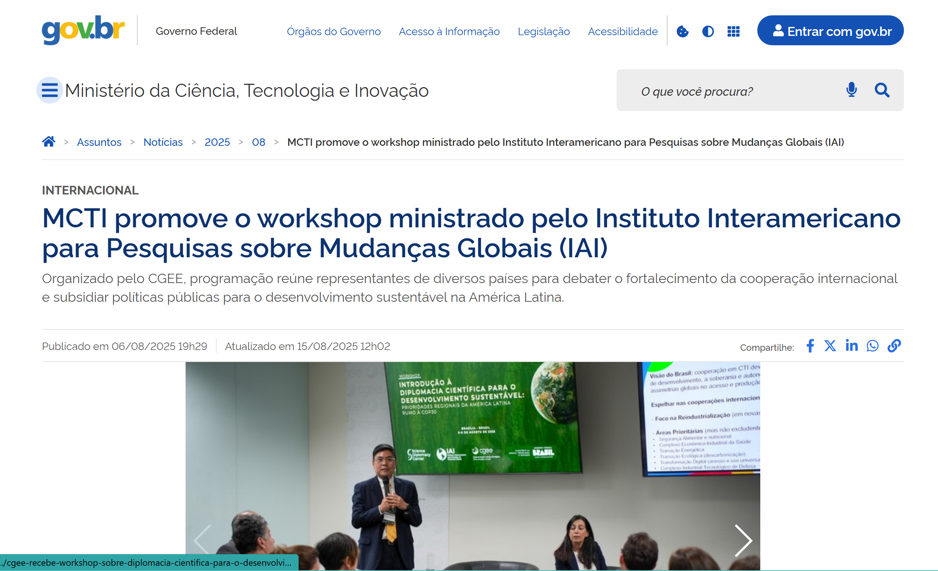
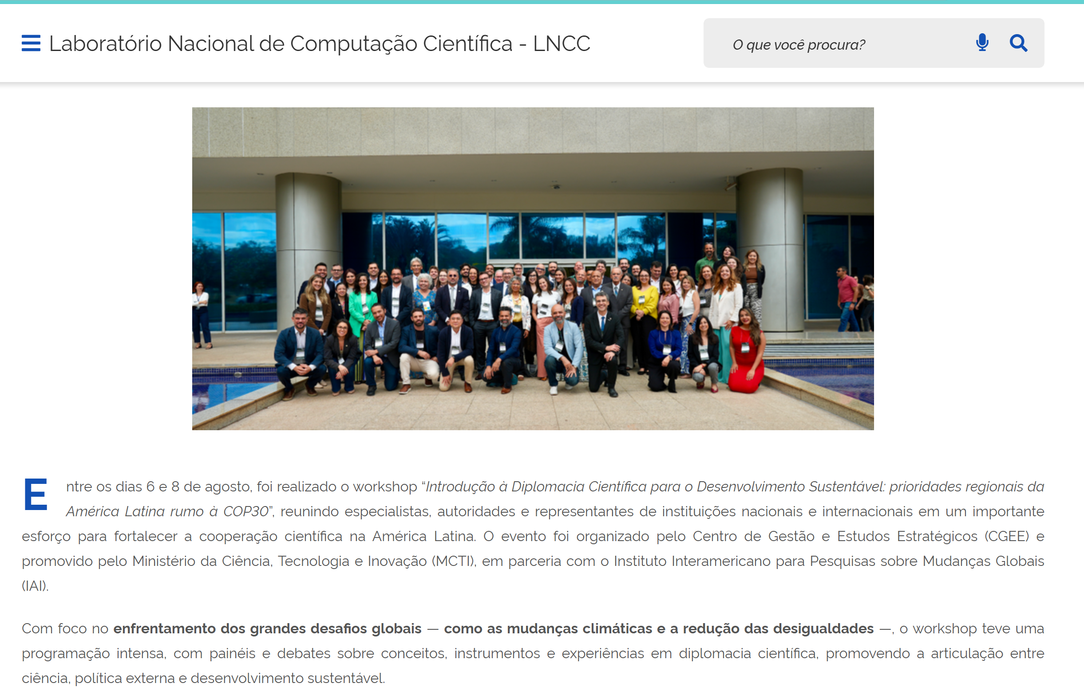
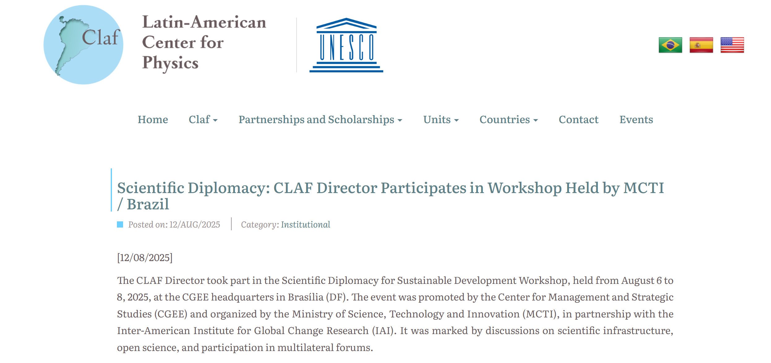
Brasil Workshop 2025: Outreach and Media Presence
"Science Diplomacy for Sustainable Development"
Launch of the Portuguese version of the IAI Science Diplomacy curriculum
Development of a policy brief on the event
Strengthening of the Latin American Science Diplomacy network

Slide 6
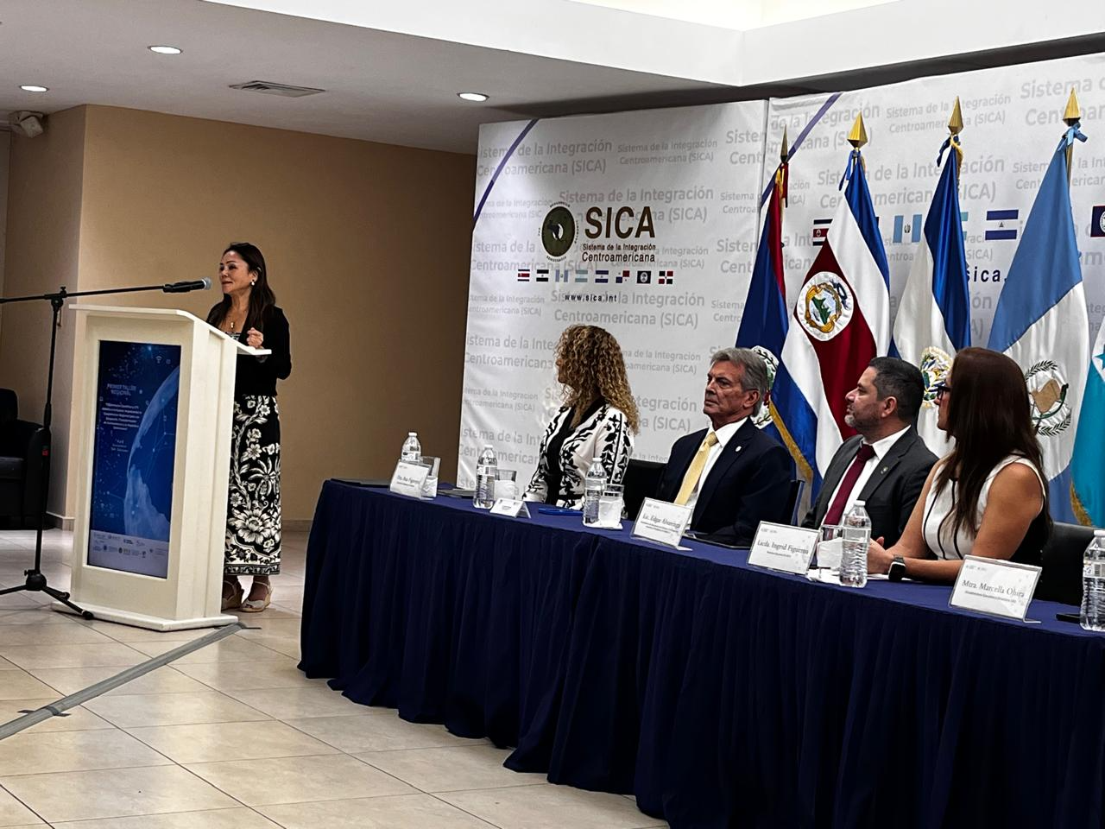
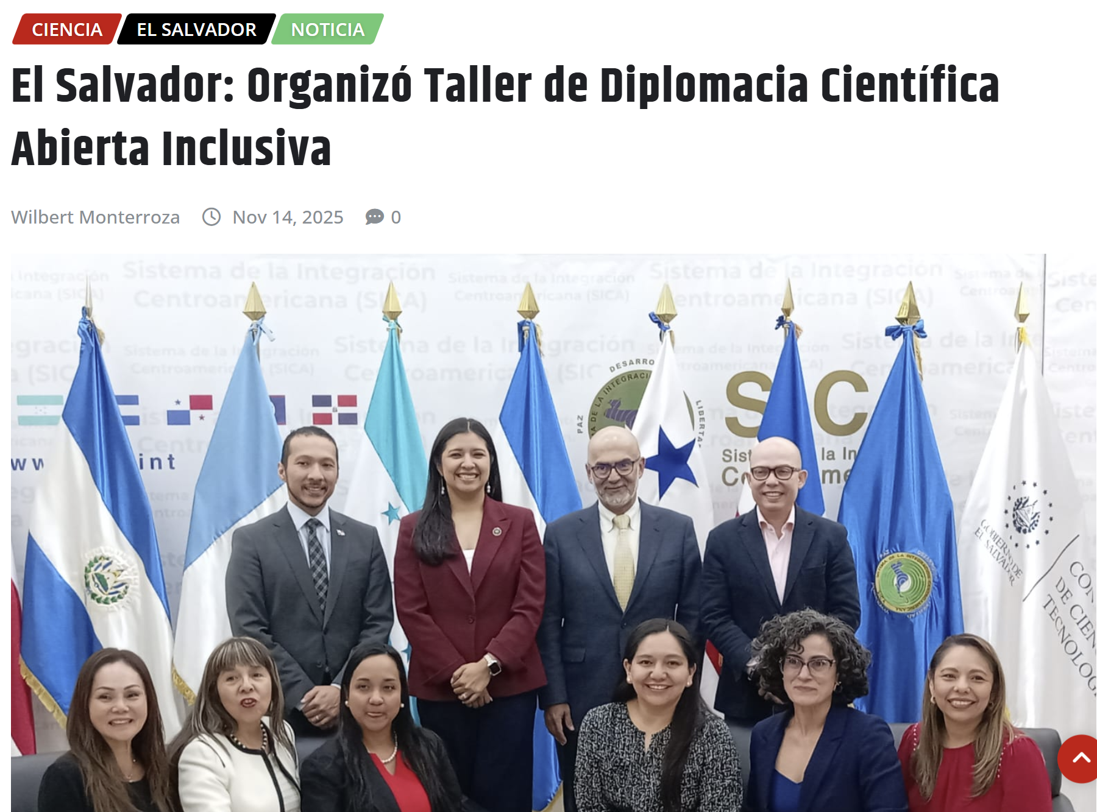
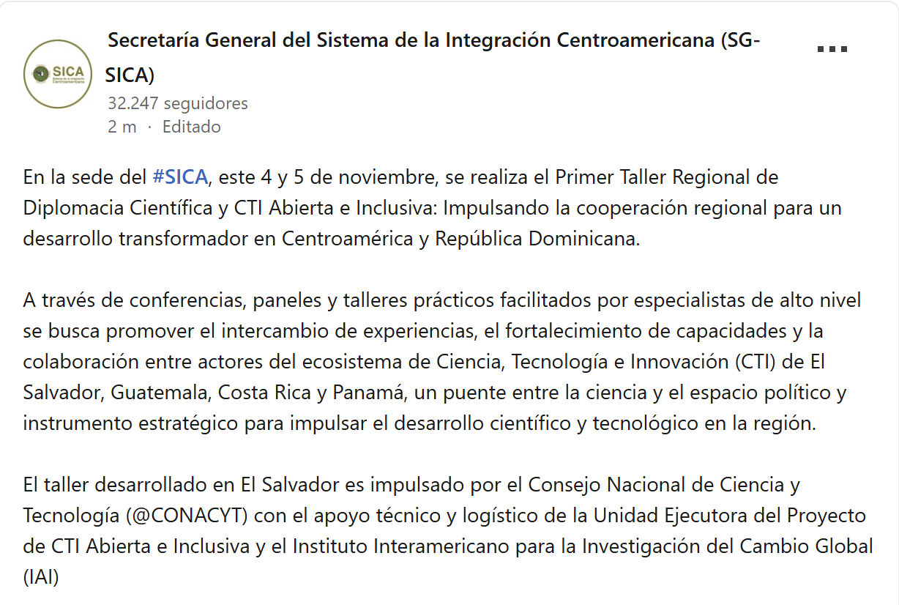
El Salvador Workshop 2025
“Open and Inclusive Science Diplomacy and STI
Promoting Regional Cooperation for Transformative Development in Central America and the Dominican Republic”
SDC Science Diplomacy Center
Open and Inclusive STI Project
El Salvador: Science Diplomacy Workshop for Open and Inclusive STI
Strengthening the Central American Network for Science Diplomacy
Integration of Central American and Dominican Republic Institutions: SICA and the Trifinio Plan
Identification of Regional Case Studies

Slide 7
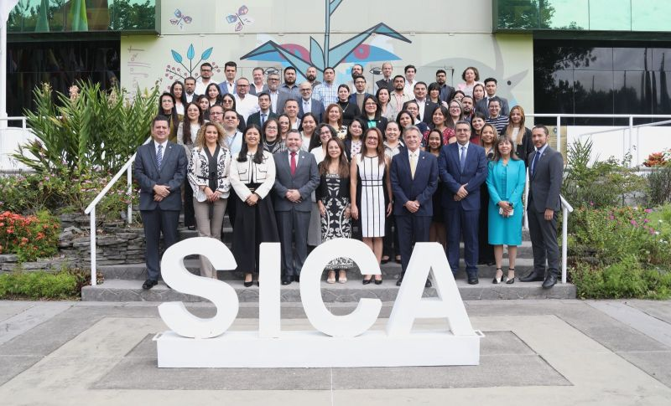
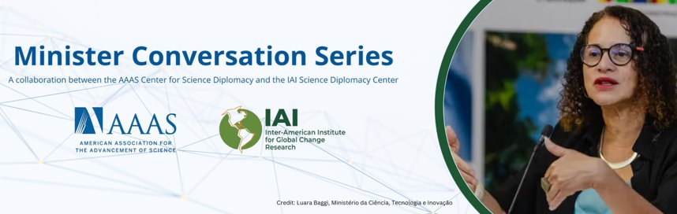
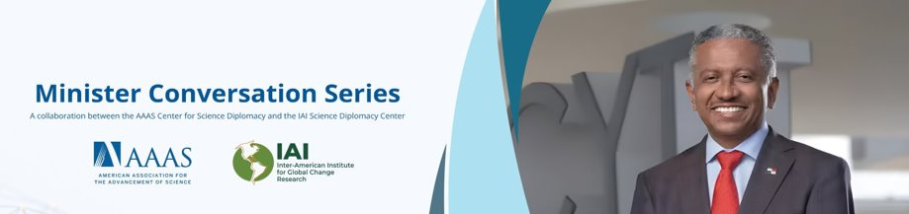
SD: The Perspective of the IAI Countries
Dr. Ortega emphasized that the IAI and the Belmont Forum in Panama position the country as a hemispheric hub for science-policy interfaces and international research collaboration, and he recognized Panama's leadership in science diplomacy and its geographic and political connectivity within the continent.
Eduardo Ortega, National Secretary of ST&I, Panama
Third Interview: Secretary Rosaura Ruiz, Mexico
Discussion of the MoU: SICA for Scientific Diplomacy and Support for Public Policies of SICA Countries

Slide 8
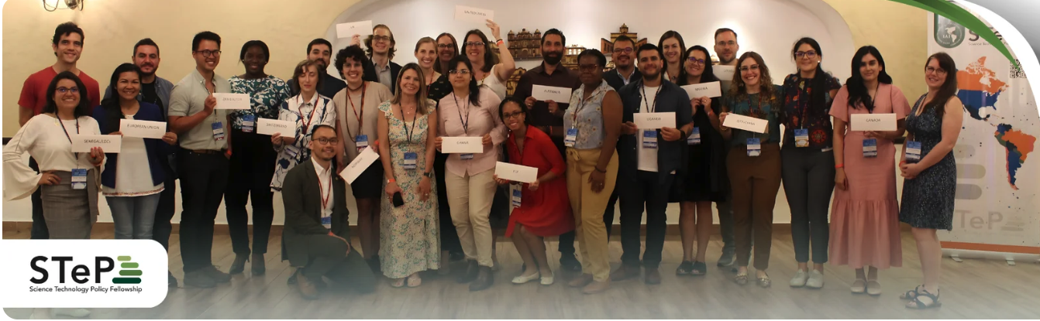
8 JAN 2026
STeP Fellowship Program Update
2020-2025
90 Fellows
16 Countries
Alumni engagement committee in place
Training future leaders of the Americas to participate in the science–policy interface through practical, hands‑on learning supported by professional development and mentorship.

Slide 9
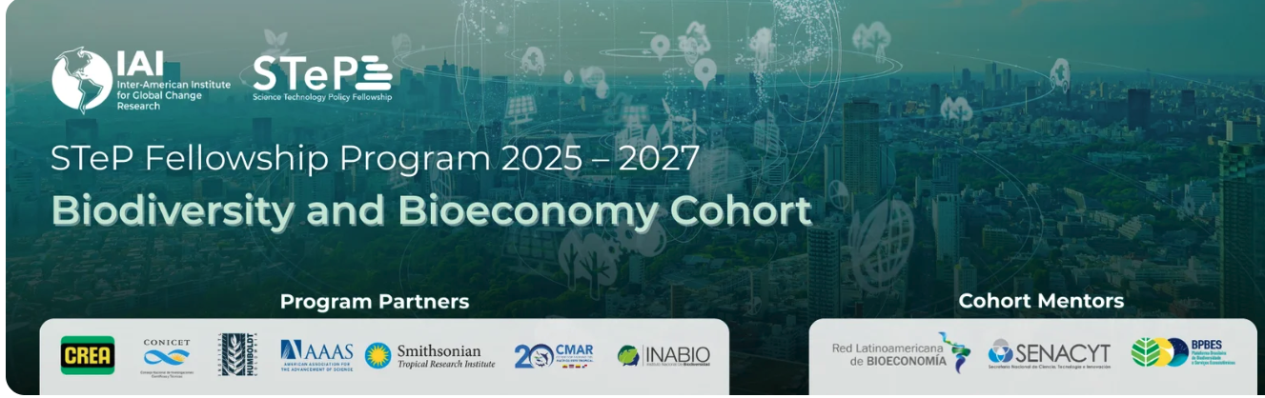
8 JAN 2026
STeP Fellowship Program Update
5th Cohort launched November 2025
9 Fellows
5 Countries
Argentina
3 fellows cofinanced by CREA/CONICET, located in the private agro-industrial sector.
Estados Unidos
2 fellows from AAAS STPF program in NSF (TIP Directorate) y U.S. DOE (BETO).
Colombia
1 fellow: Alexander von Humboldt Institute
Panamá
1 fellow in STRI – Iniciativa Adrienne Arsht, advicing CMAR (Costa Rica, Panamá, Ecuador, Colombia).
Ecuador
2 fellows: Instituto Nacional de Biodiversidad (INABIO)

Slide 10
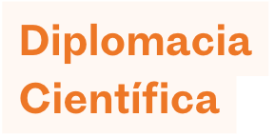
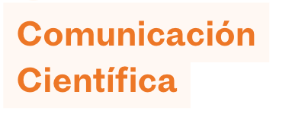

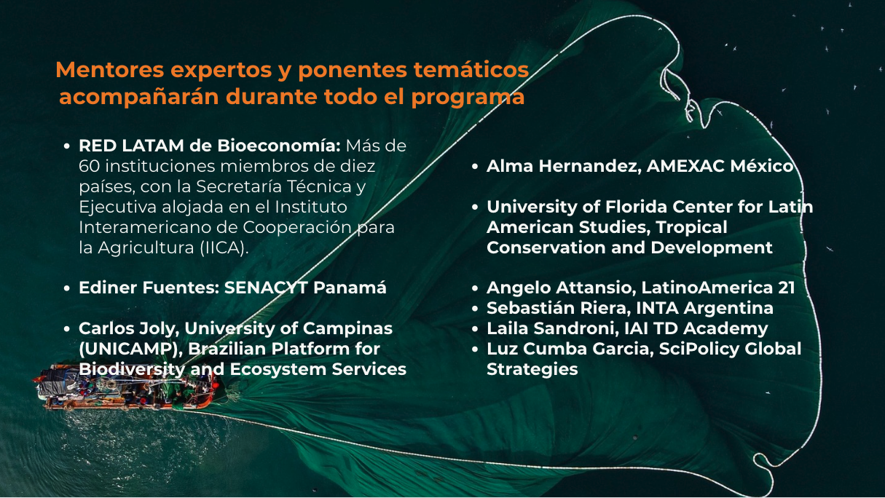
8 JAN 2026
STeP Fellowship Program Update
Professional Development
14 training sessions and (28 hours of synchronous training) scheduled through Nov 2026
+ Asynchronous online SD course
+ Communication assignments
+ M&E with host institutions

Slide 11
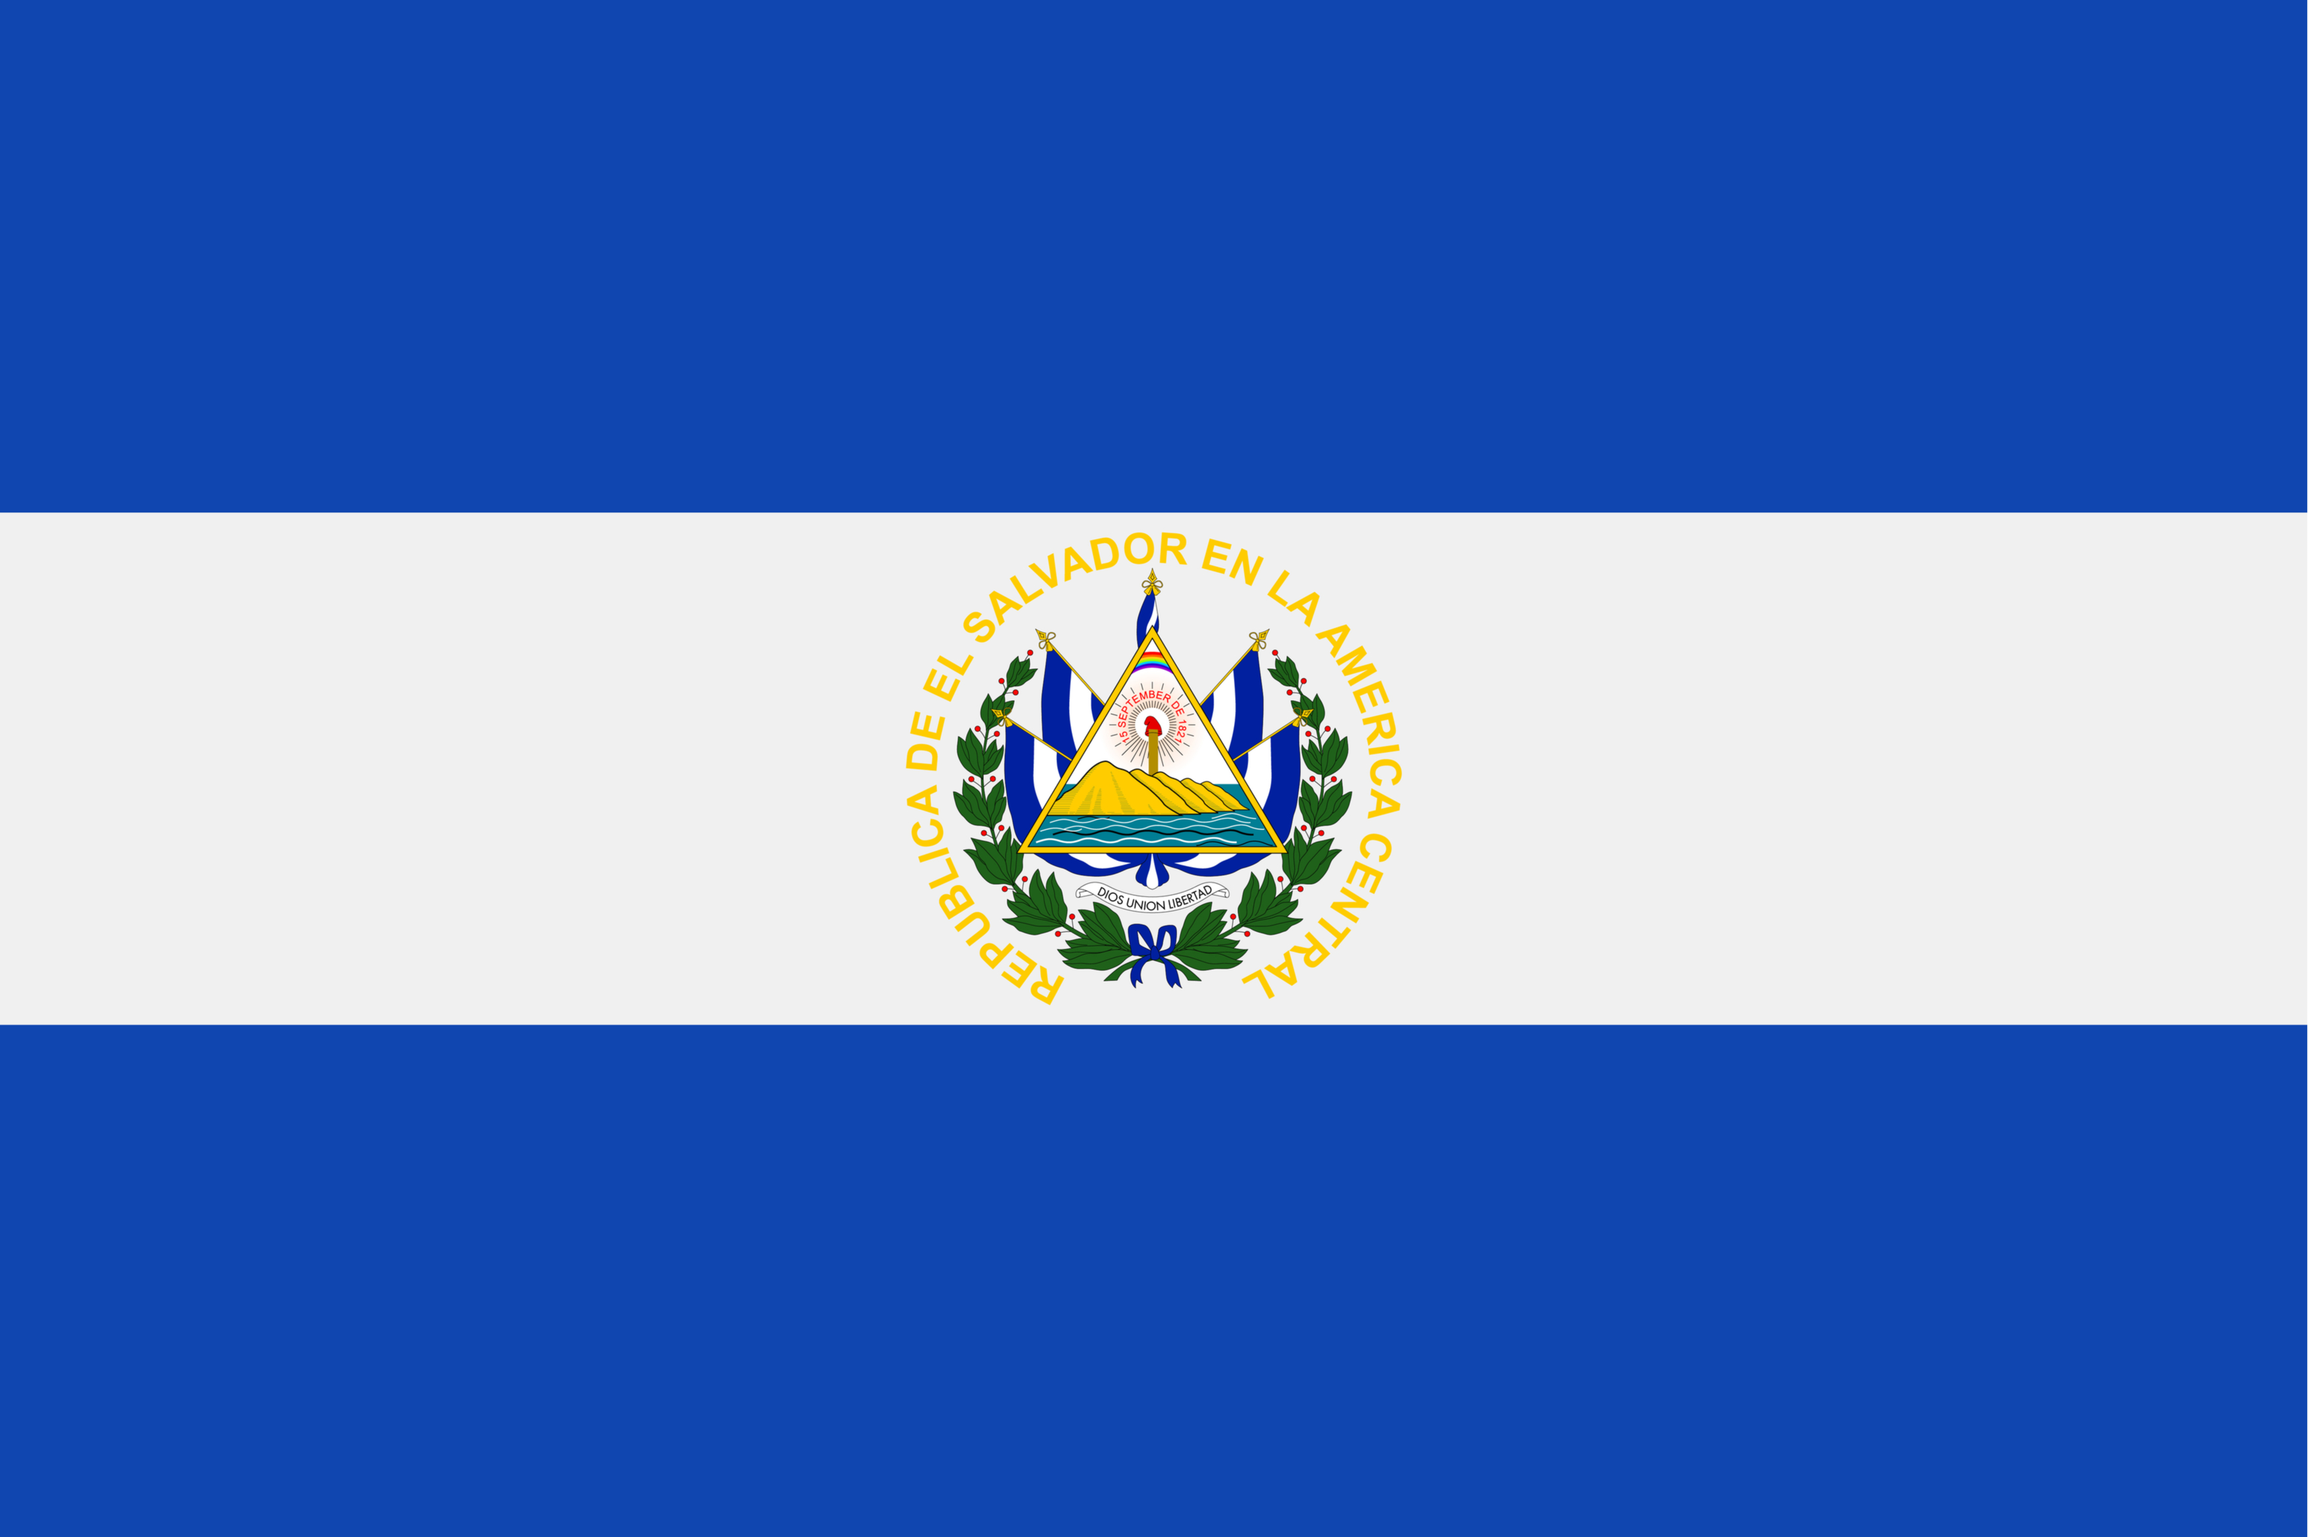

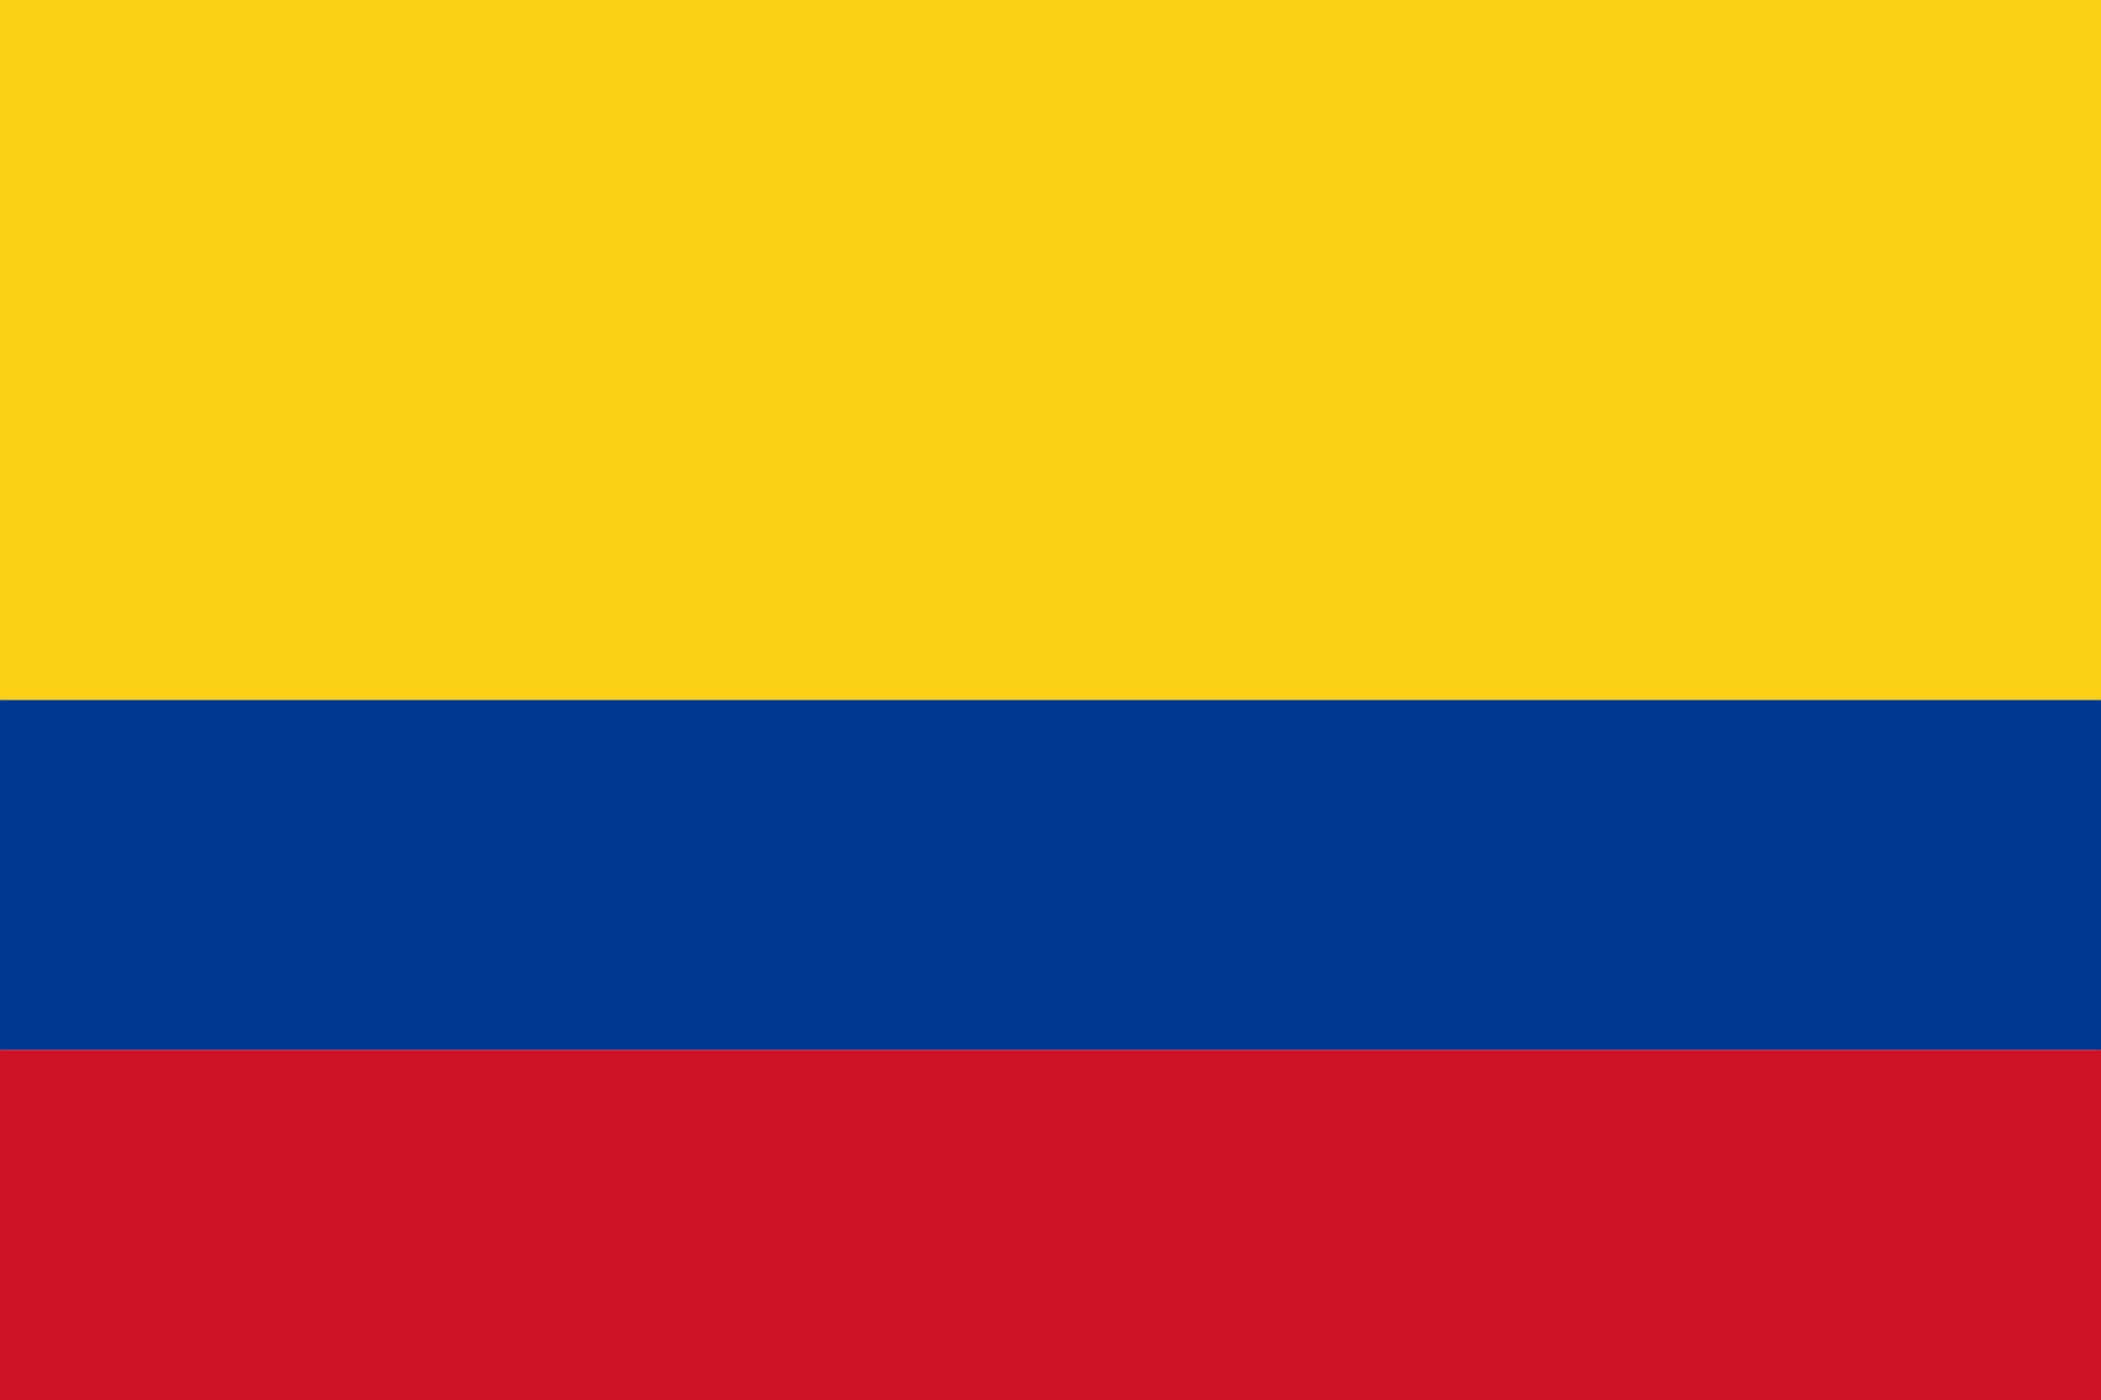
8 JAN 2026
C Growing interest in Science Diplomacy
Political and diplomatic interest​
Creation of a trust fund financed by subnational governments. IDEAM and IAI participate.
Collaboration in DC with CONACYT is fundamental for the country's accession to the IAI.
May 2025. The Vice Minister of Education, Science & Technology submitted the accession request to the Ministry of Foreign Affairs.
The Minister of Foreign Affairs forwarded the process to the Presidential Palace, where it is currently under review.
It then went to the Legislative Assembly for final approval.
The Ministry of Foreign Affairs will deposit the document with the OAS for accession.
Institutional and financial collaboration.
Topics of interest: Antarctica.
Interest in creating an Institute of Scientific Diplomacy in collaboration with the IAI, with funding support for IAI personnel, programs, and activities.
Focus on subnational government.
“South American Meeting for the Andes Mountains” (October 23-24, 2025, Tolima, Colombia).
Initiative of subnational governments from 7 Andean countries, in collaboration with the Andean Mountain Range Initiative (AMI). • Creation of the Ad Hoc Group for Subnational Cooperation in the Andes Mountains as a platform to strengthen multi-level governance and cooperation.
Creation of the Andean Scientific Panel and its First Report on the Current State of the Andes Mountains, integrating scientific knowledge, local perspectives, and community participation.
The IAI was invited to collaborate on the Panel's conceptualization.
Central America
Southern Cone
Andean Region
Notes:
3 columnas, centroamerica, cono sur, andes
1 objetivo politico intl
2 ayuda a collab institutcional y financiera
3 ej gov subnacional

Slide 12

8 JAN 2026
Growing interest in Science Diplomacy and Funding
Fundraising
Science Diplomacy Events
2025: Funding from Paraguay, Brazil, and El Salvador
2026: Funding from MESCyT/Dominican Republic + STI Project; CONCYTEC/Peru, OEI; UNCCD
Dialogue with 3 other countries
Projects
2026-2027: Canada Alinea and Global Affairs Canada. Signing of grant agreement
Proposals
Embassy of the United Kingdom in Panama for events in Panama: Science Diplomacy and Entrepreneurship
Government of Uruguay: Center for Science Diplomacy
Multilateral Financial Interest
Collaboration in Science Diplomacy with the Development Bank FONPLATA
FONPLATA-IAI Project Proposal for the International Climate Initiative (IKI) of 15 M Euros
Project on Integrating Biodiversity into Development Finance for the Implementation of NBSAPS (National Biodiversity Strategies and Action Plans). IKI requests participation from multilateral banks.

