Slide 1

Science Program Activities
Omar R. López
Matías Mastrangelo
Laila Sandroni
Daniella Guerrero
Daniel Pinillos

Slide 2

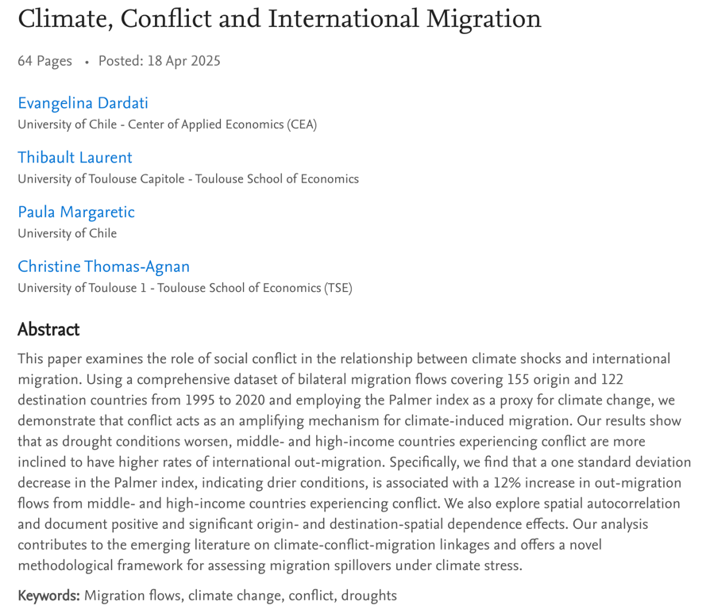
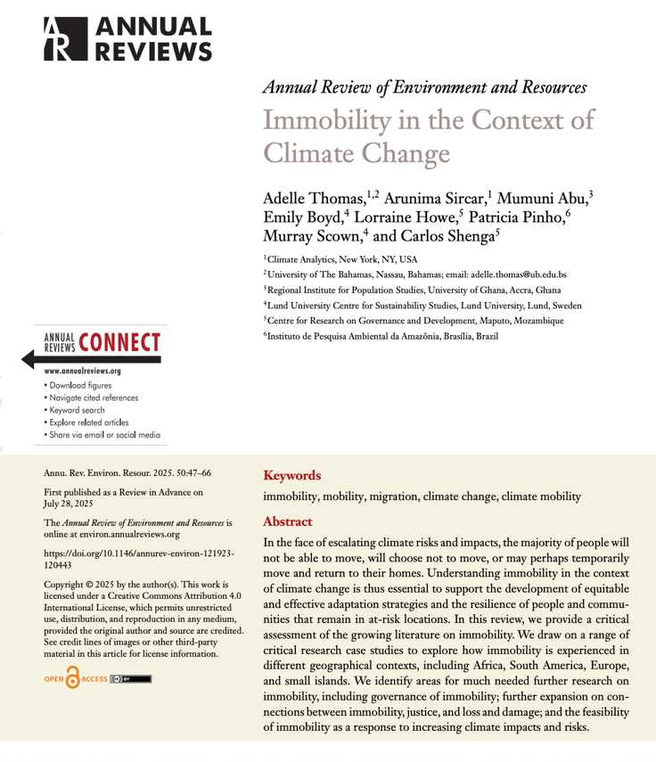
Science Programs in Progress: Migration and Mobility
JAN 8, 2026
3 CRA Projects
Notes:
Our Science program has three projects on the interrelationship between climate change and migration. Here are two products of these projects, one that seeks to understand why people do not move, as an essential part of fair and effective adaptation. The other explores how social conflicts accentuate or amplify international migration, but emphasizes how droughts tend to increase migration to a greater extent.

Slide 3
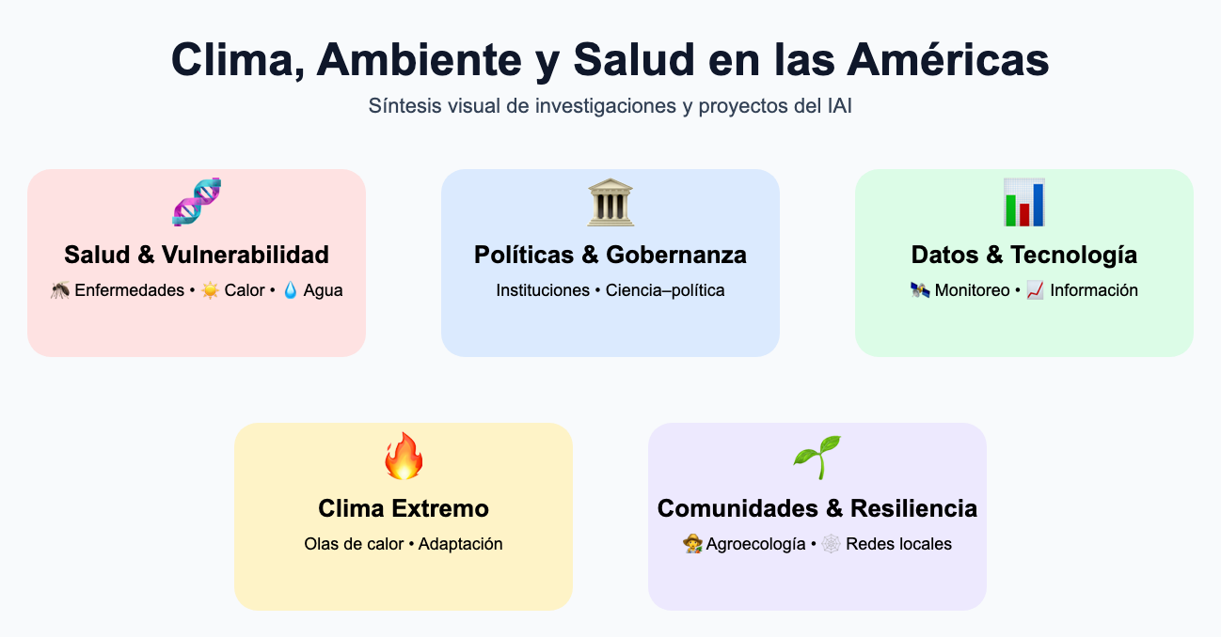

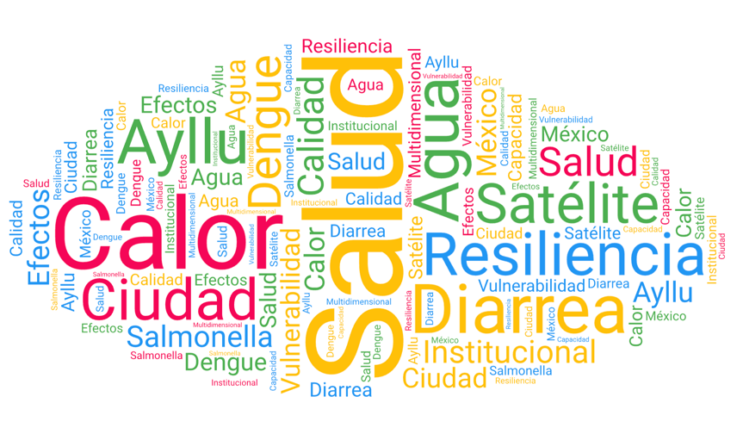
Science Programs in Progress: Climate, Environment, and Health
JAN 8, 2026
12 Seed Projects + 6 CR Teams
$120K + $600K

Slide 4
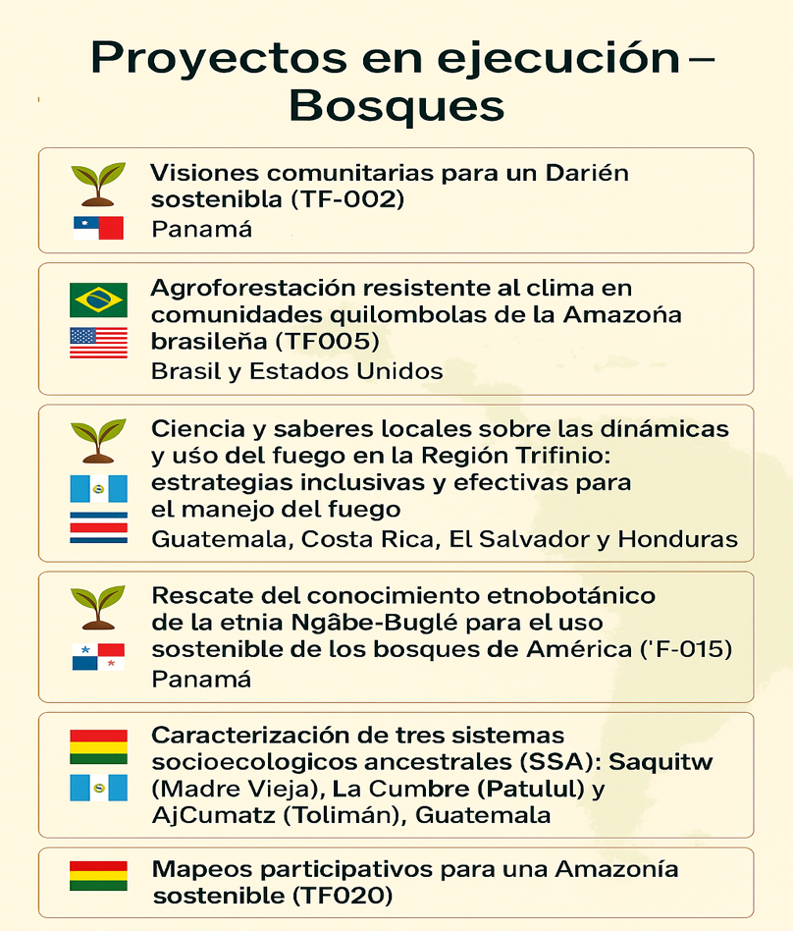



JAN 8, 2026
$230K committed
8 Seed Projects

Slide 5
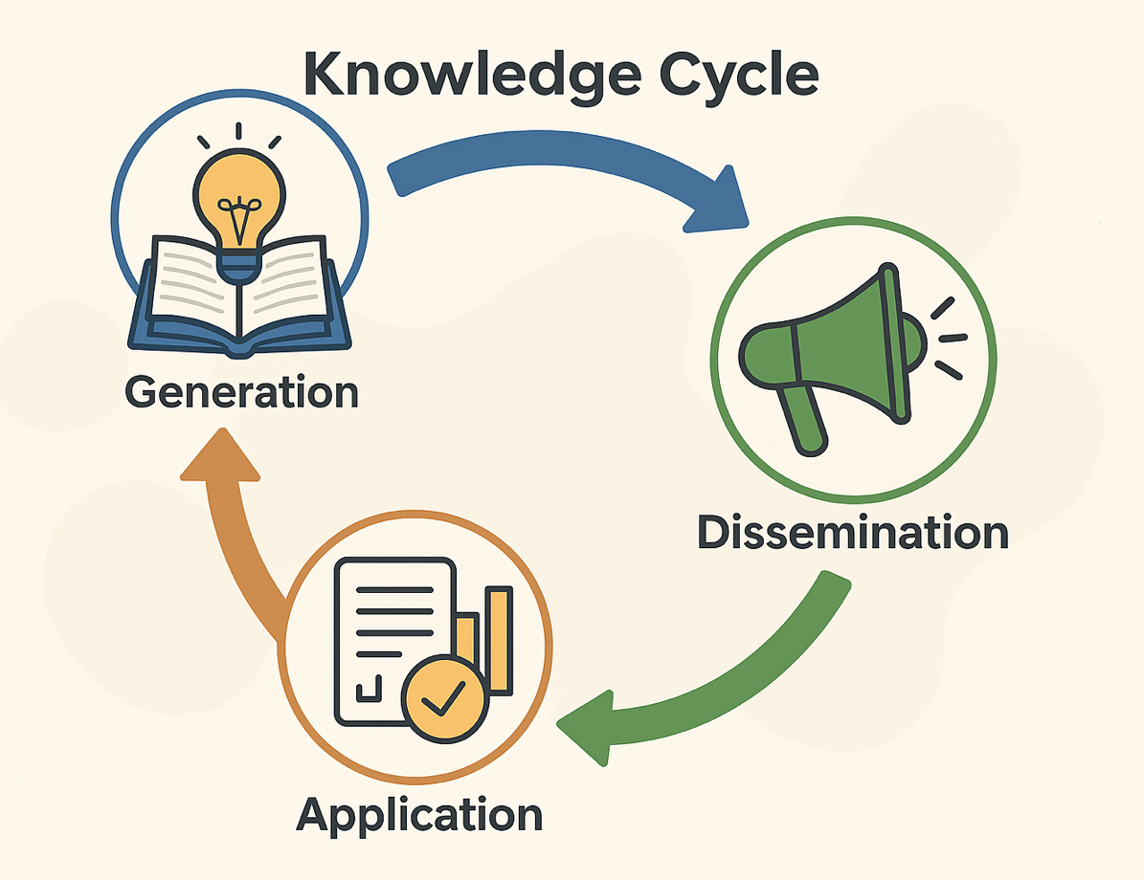
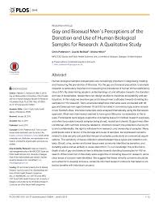
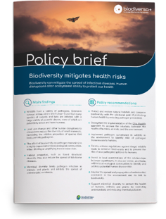


JAN 8, 2026
Science in support of decision-making

Slide 6
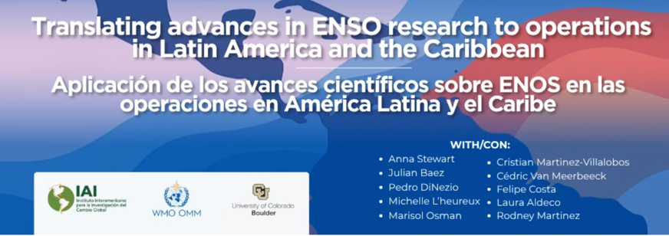
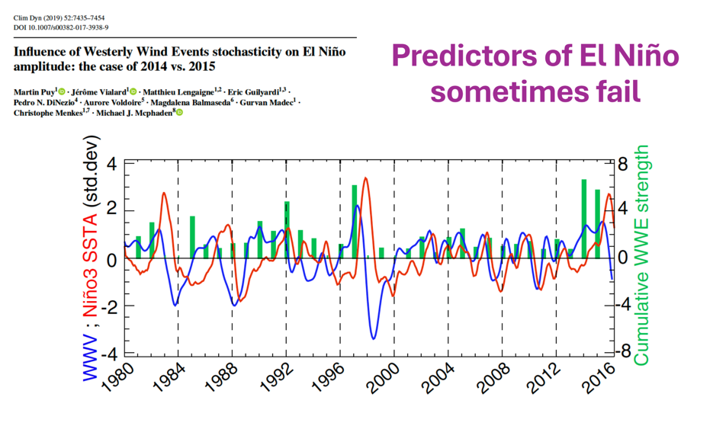
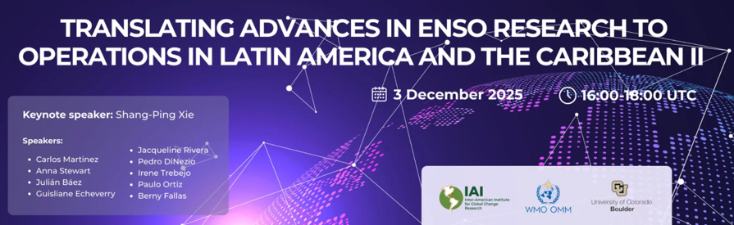
JAN 8, 2026
Climate Science at the service of the region
> 3,000 registered
Notes:
July 3. Operational ENSO forecasting and subsequent seasonal products do not necessarily incorporate or reflect the evolving science and understanding of ENSO and its regional impacts.
December 3, 2025, implications for climate services across the Americas.

Slide 7
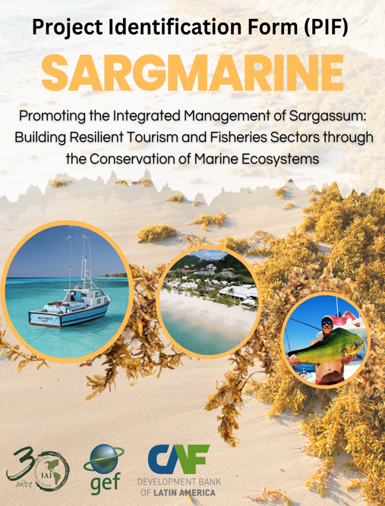








JAN 8, 2026
Building bridges of collaboration in the region
LAC Scientific Community
UNESCO
GEF Project $10 Million

Slide 8

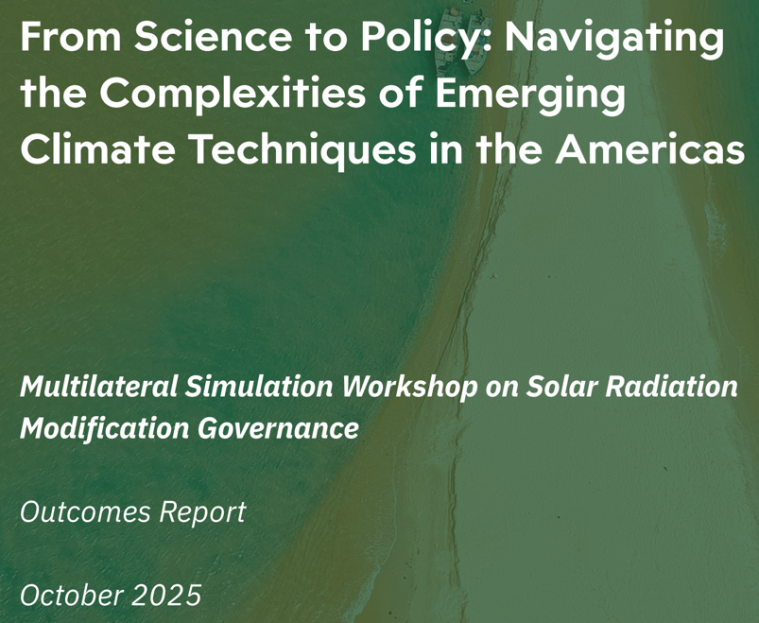


JAN 8, 2026
Other activities: Amplifying the voice of LAC in the governance of climate intervention techniques
Participation of 13 member countries

Slide 9
JAN 8, 2026
Promoting regional integration through science
"We will continue to seek strategic resources to promote research and training, and keep knowledge generation at the heart of our mission."

