Slide 1

Overview of the Core Budget and Country Contributions for FY 2025-2026
Valeria Villamil

Slide 2

4 DEC 2025
Country Contributions
As of October 31, 2025, contributions received (cash income) for the 2025-2026 exercise represent 20%

Slide 3
4 DEC 2025
Status of the Core Budget and Expenses
Table II shows accumulated expenses until October 31 (4 months since the beginning of the fiscal year).
2. Expenditures were -13% lower than anticipated in the core budget.

Slide 4
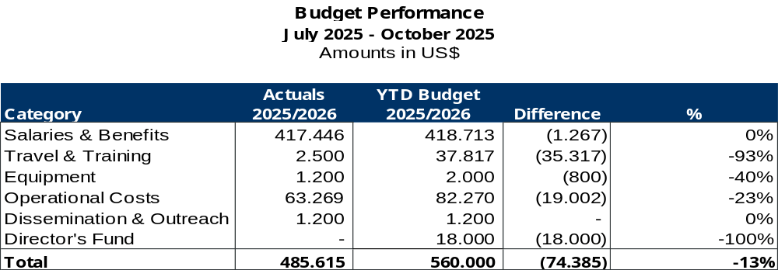
4 DEC 2025
Status of the Core Budget and Expenses

Slide 5
4 DEC 2025
Status of the Core Budget and Expenses
Salaries and benefits
Expenditures on salaries and benefits remained in line with the budget for the fiscal
year 2024–2025. Implementation reflected balanced management of resources, with
no significant changes from initial projection.
Travel
During the period, some of the budgeted trips were not made due to the financial
situation that IAI is going through. However, certain trips and training activities were
carried out and made possible thanks to the obtaining of external funding.

Slide 6
4 DEC 2025
Status of the Core Budget and Expenses
Equipment
Total equipment costs were significantly lower than budgeted. Only one piece of
equipment considered essential to guarantee institutional operation was acquired,
given the financial context that the IAI is going through.
Operational costs
Operational costs were reduced as much as possible given the financial situation that
the IAI is going through. As a result, expenditure in this category was significantly
lower than anticipated, with a reduction of 23% compared to the approved budget.

Slide 7
IAI Financial situation 2025–2026
Valeria Villamil

Slide 8
4 DEC 2025
Objective
• Present the current financial situation
• Analyze the gap between costs and resources
• Identify risks and decision needs

Slide 9
4 DEC 2025
IAI current structure
• 8 permanente staff
• 2 technical consultants
• 6 fellows
• Consultants: IT, design, virtual campus, servers.

Slide 10
4 DEC 2025
Approved Budget COP33
• Total approved budget: USD 1.680.000
• Total annual cost (travel not included): USD 1.288.380

Slide 11
4 DEC 2025
Financial Gap
• Annual personnel cost: USD 1.288.380
• Approx. available income 2026-2027: USD 475.000, represents only the 37% of the annual personnel cost.
Significant and structural gap.

Slide 12
4 DEC 2025
Key Limitations
• High dependence on contributions not received
• Mostly restricted funds
• Non-recurrent income

Slide 13
4 DEC 2025
Key Message
• The current structure is not financially sustainable
• Relevant institutional risk
• Early and planned decisions are required

