Slide 1

Directorate Report
Anna Stewart Ibarra

Slide 2

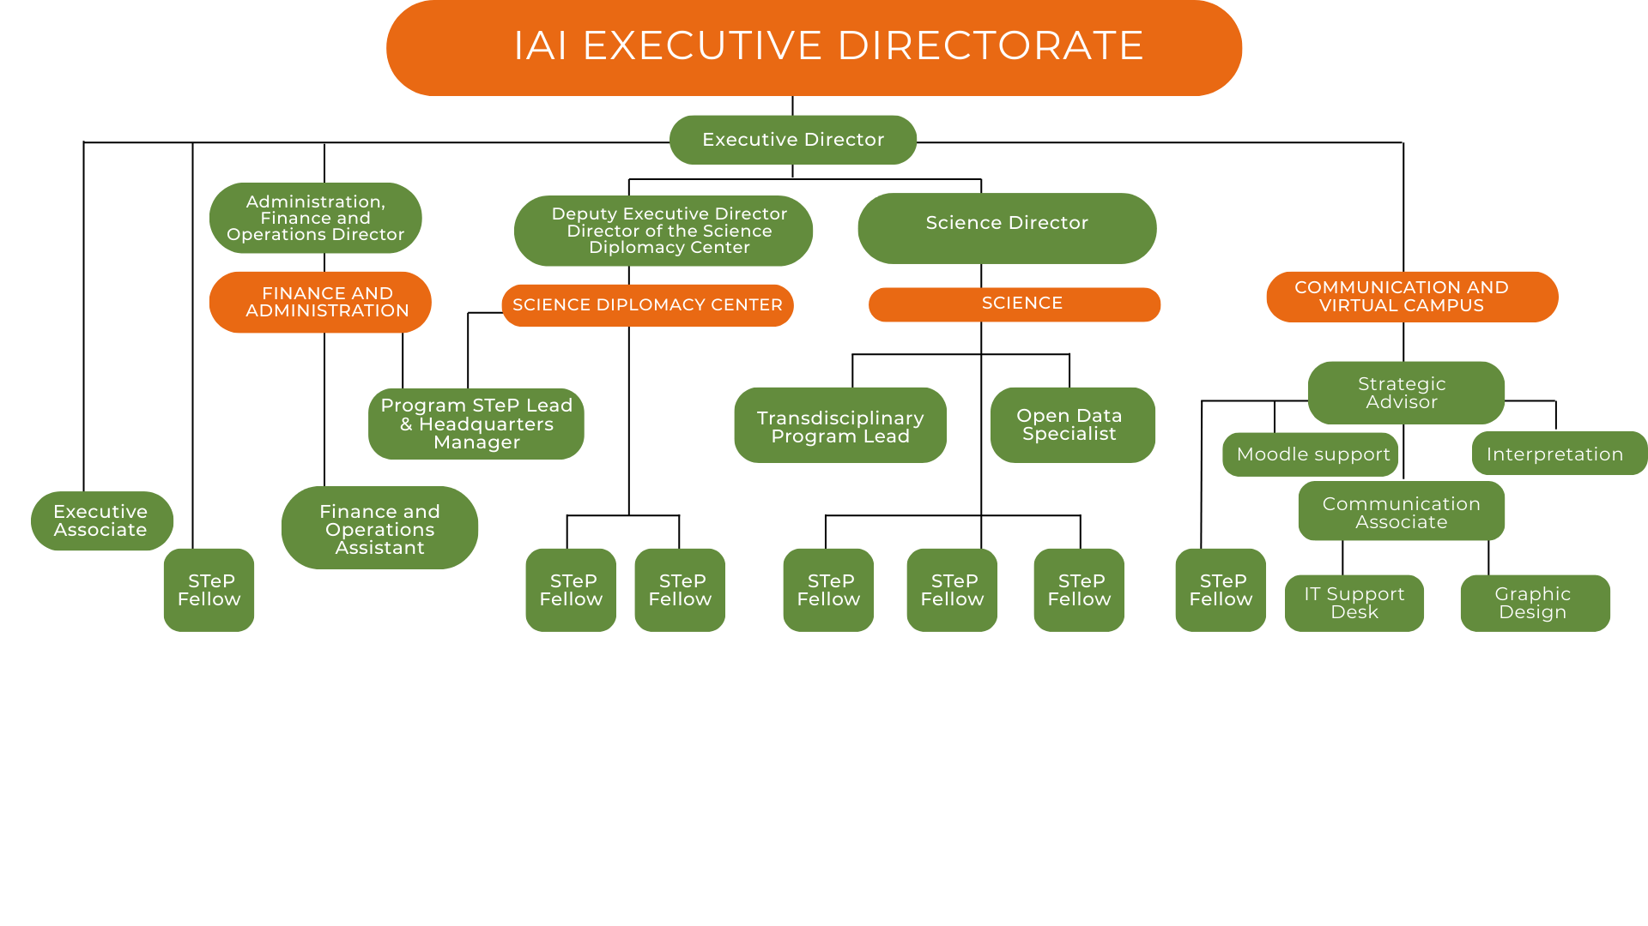
4 DEC 2025

Slide 3
4 DEC 2025
Diversification of Funding
Multilateral development banks in the Americas
Technical cooperation agreement signed with CAF in December 2025
Collaboration agreement signed with Financial Fund for the Development of the Plata River Basin (FONPLATA) in December 2025
Engagement with funders
Funders Aligned for Sustainability Transformations (FAST) Forum
Ocean Decade Fifth Foundations Dialogue
Belmont Forum Foundation 501 (c) (3)
Advising the Rockefeller Foundation, Canada Grand Challenges
Grants
Pandemic Fund, Wellcome Trust, Horizon Europe, CF & H Foundation, IKI, GEF8, UK Aria, NASA, Global Affairs Canada, and others

Slide 4
4 DEC 2025
Multilateral Environmental Engagement
3rd United Nations Ocean Conference (UNOC3, France)
BRICS Young Scientist Forum (Brazil)
CBD SBSSTA-27 and SB8J-1 (Panama)
UNFCCC COP30 (Brazil)
UNCCD CRIC 23 (Panama)
Invitations to co-host future global convenings:
Third International Conference on Health and Biodiversity (2026 Ireland)
Adaptation Futures (2027 Mexico)

Slide 5
4 DEC 2025
Indigenous Peoples Advisory Committee (IPAC)
Regular meetings of the newly established IPAC and joint meetings with SAC and SPAC
Onboarding of IPAC members
Rules and procedures of the IPAC drafted
Active promotion of IPAC members in international events:
  The Intergovernmental Panel on Climate Change (IPCC) Expert Meeting on Gender, Diversity, Equity, and Inclusivity
  Multilateral Simulation Workshop on Solar Radiation Management (SRM) Governance
  Online Course “Scaling-Up Health Adaptation Measures to Meet the Climate Change Challenge in the Americas”
  Side event to the UNFCCC COP30 at the Oceans Pavilion
  The Latin American One Health Congress

Slide 6
4 DEC 2025
Training & Education
In-person training
Science Diplomacy in Brazil and in El Salvador (Aug and Nov)
Solar Radiation Modification in Colombia (Sept)
Climate and Health Modeling in Brazil (Nov)
Virtual training
A Transdisciplinary Look into the Future of the Oceans with CR2 Chile and Belmont Forum
Scaling Up Health Adaptation Measures to Meet the Climate Change Challenge in the Americas with Columbia University, Health Canada, FIOCRUZ, PAHO, Earth Medic
Pilot: Remote Sensing and Geographic Information Systems with Stanford University and National Geographic.

