Slide 1

Communication and Virtual Campus
Irene Torres

Slide 2
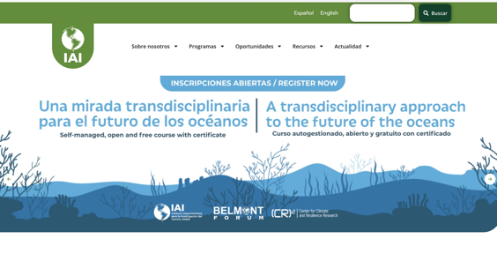

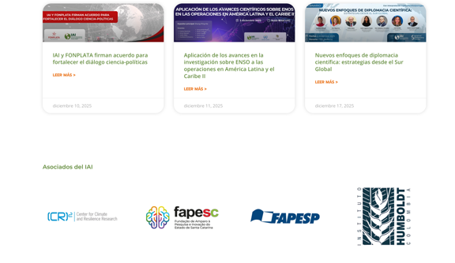
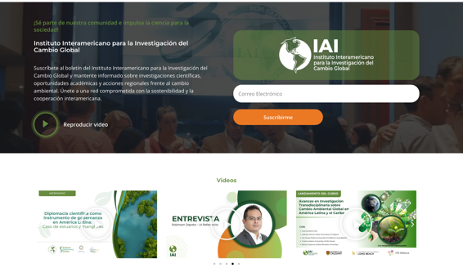
Website
8 JAN 2026
News and opportunities
10,000 files
Associates
Suscribe
Videos

Slide 3


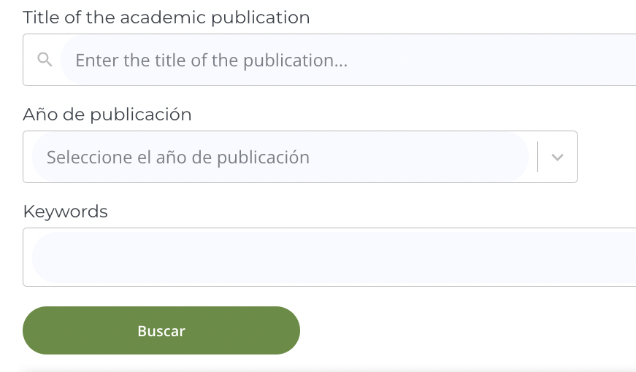

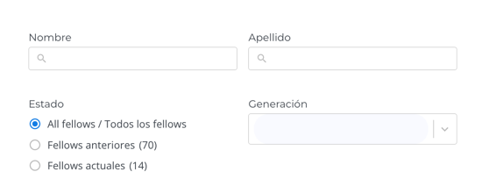
Website
8 JAN 2026
3 searchable databases
102 experts
2
1
3

Slide 4



Social networks
8 JAN 2026
Linkedin
248.556 impressions
1 Jun – 30 Nov 2025
Instagram
33.370 accounts reached
until 30 Nov 2025
Mailing list
6.538 active emails
until 30 Nov 2025

Slide 5
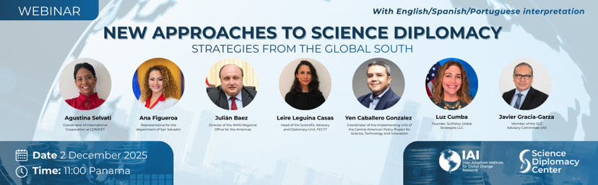
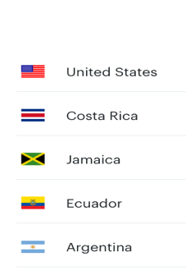
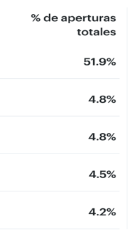

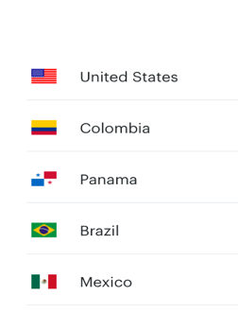
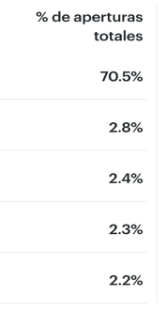
Webinars
8 JAN 2026

Slide 6




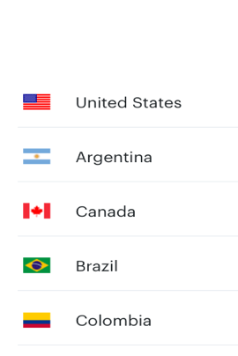
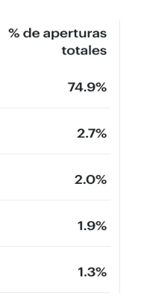
8 JAN 2026
Newsletter and news

Slide 7

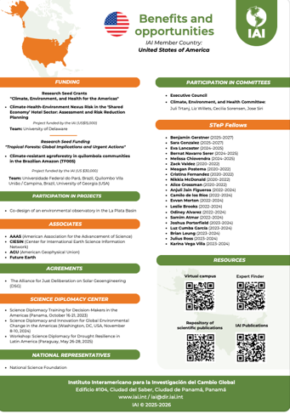
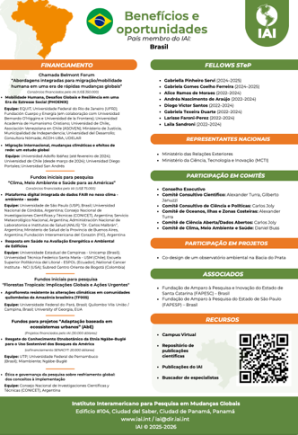
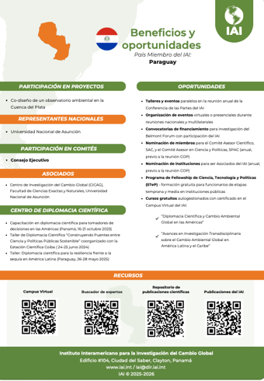
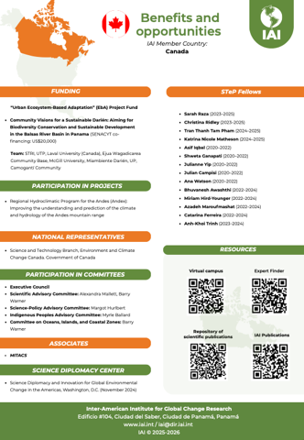
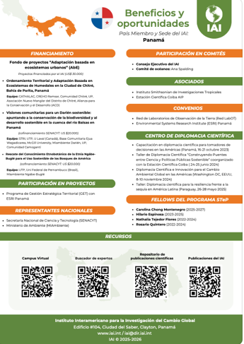
Publications
8 JAN 2026
Member country sheets
+1,000 downloads

Slide 8
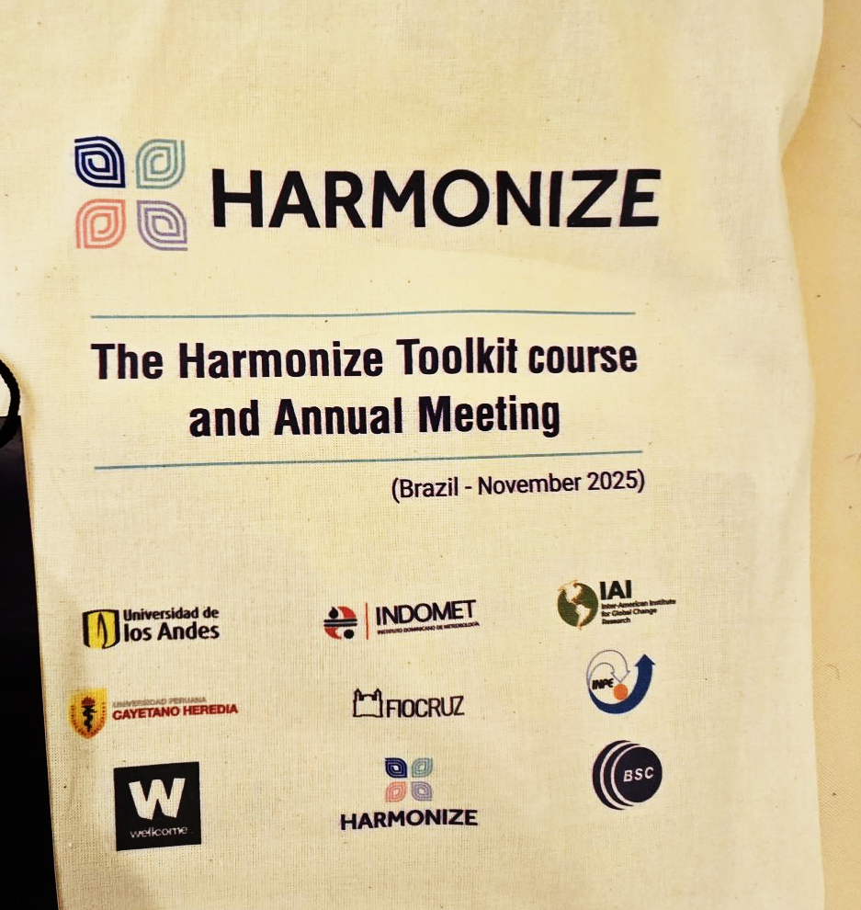
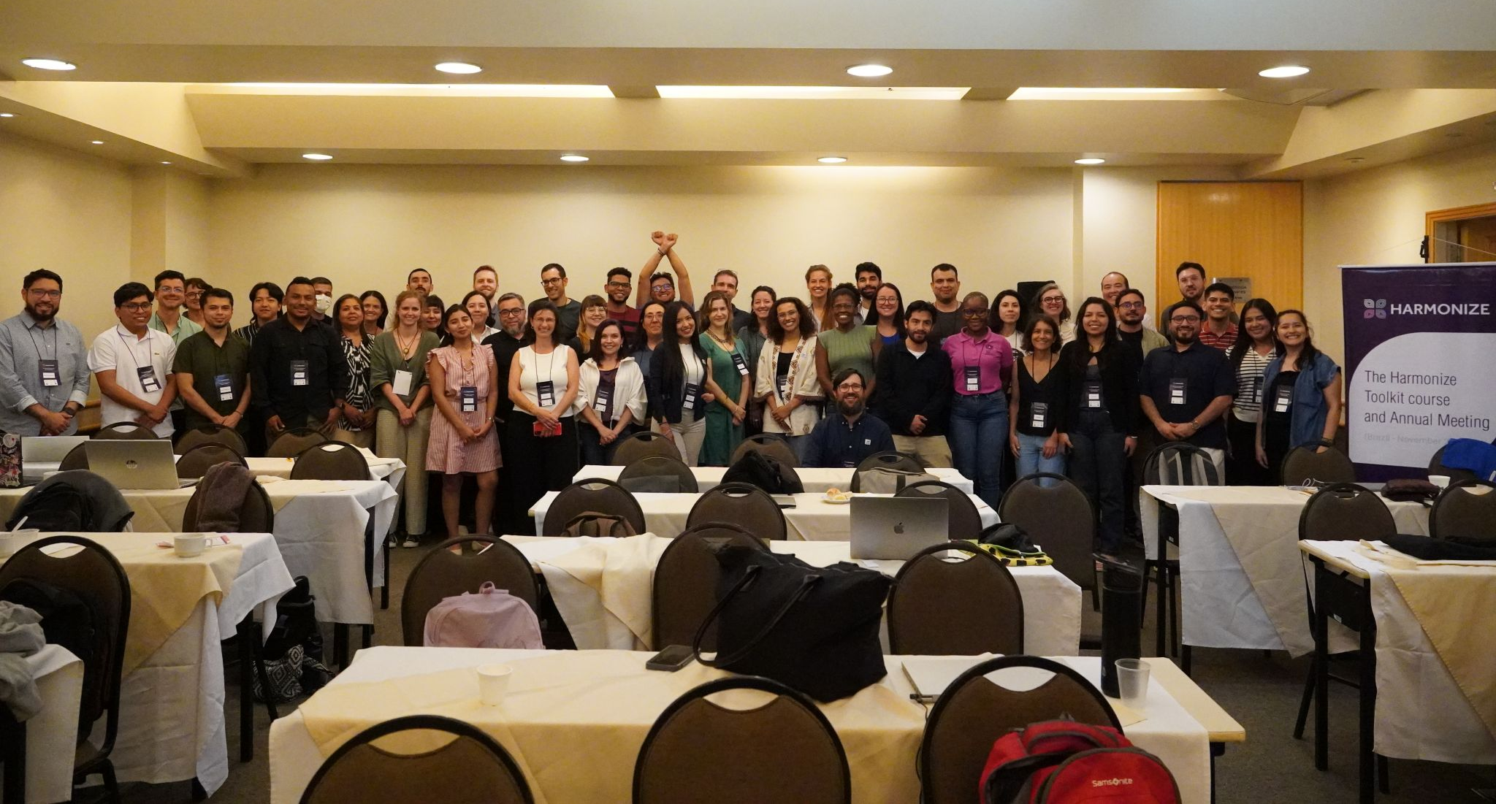
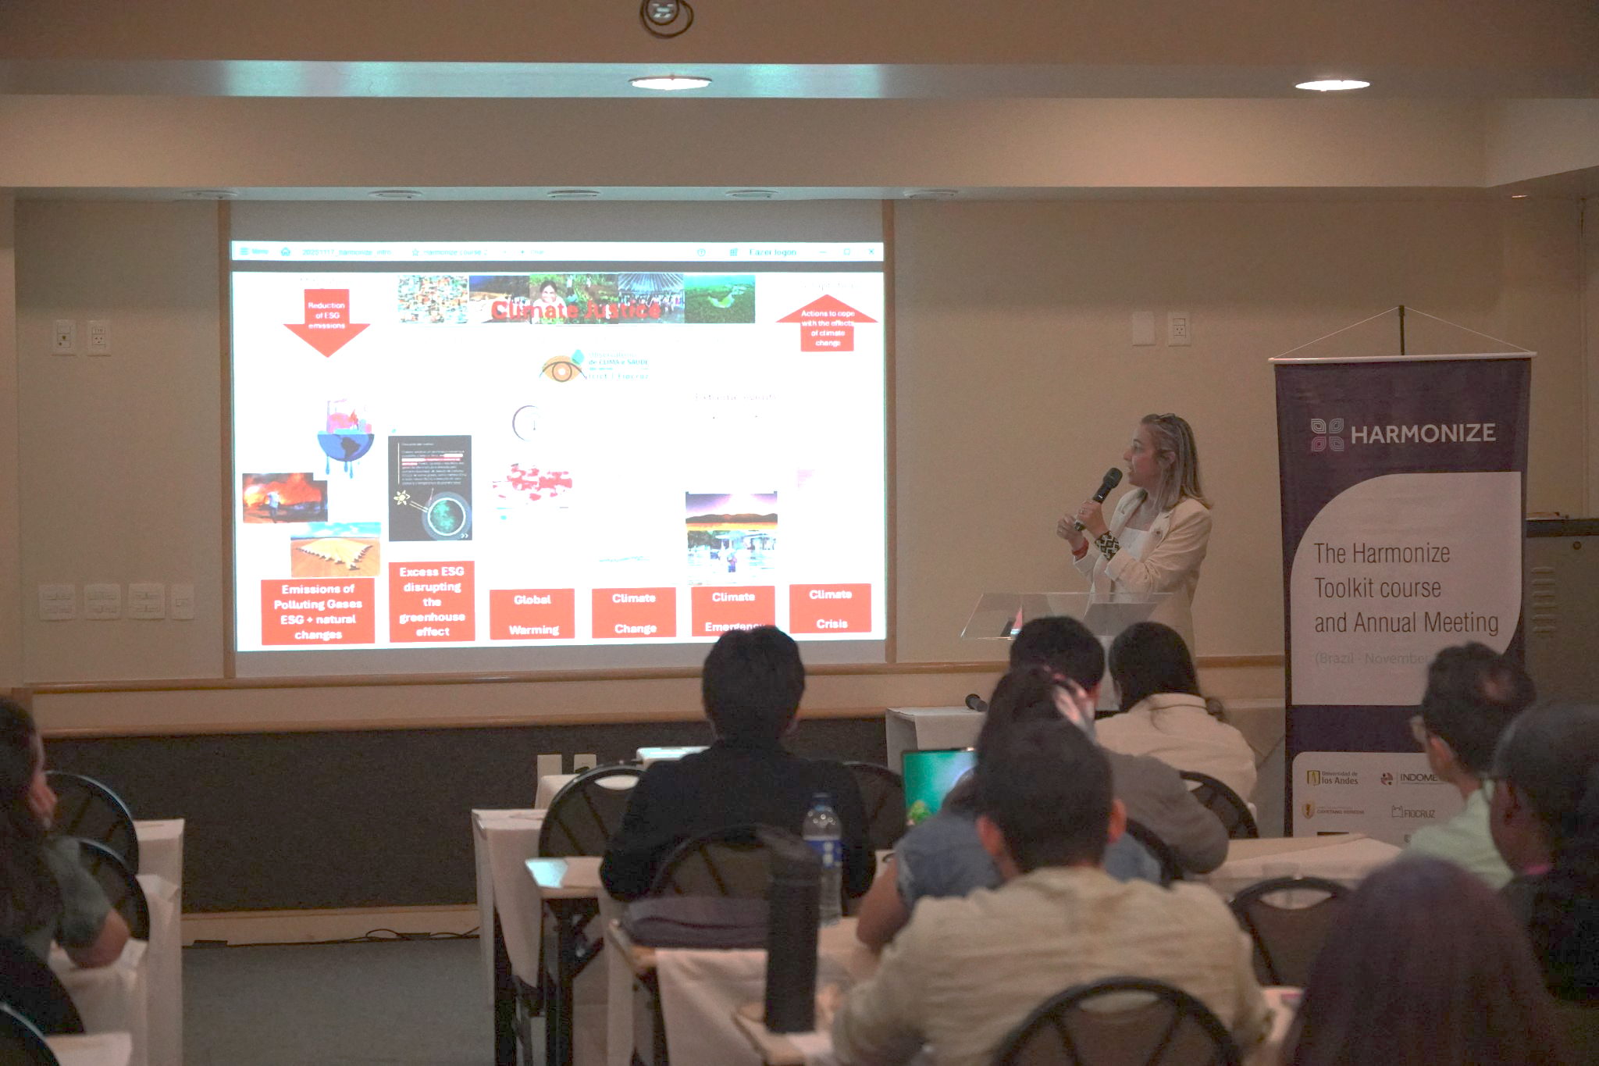
Partnership
8 JAN 2026

Slide 9
Partnership
8 JAN 2026
CLIMATE AND HEALTH INTELLIGENCE INITIATIVE
Barcelona Supercomputing Center (BSC)
Red Cross Red Crescent Climate Centre (RCCC)
Inter-American Institute for Global Change Research (IAI)
Caribbean Institute for Meteorology and Hydrology (CIMH)
African Centre of Meteorological Applications for Development (ACMAD)
National University of Singapore (NUS)
Wellcome Trust Discretionary Award
Budget: €16 million

Slide 10
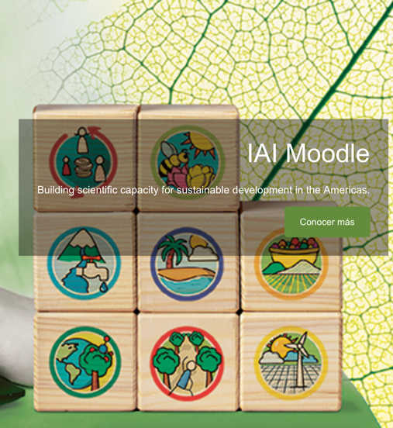
IAI’s Virtual Campus
8 JAN 2026
OFFLINE COURSES
4306 total registrations
1 JUN – 30 NOV 2025: 1695 new registrations
725 total certificates
1 JUN – 30 NOV 2025: 217 new certificates

Slide 11
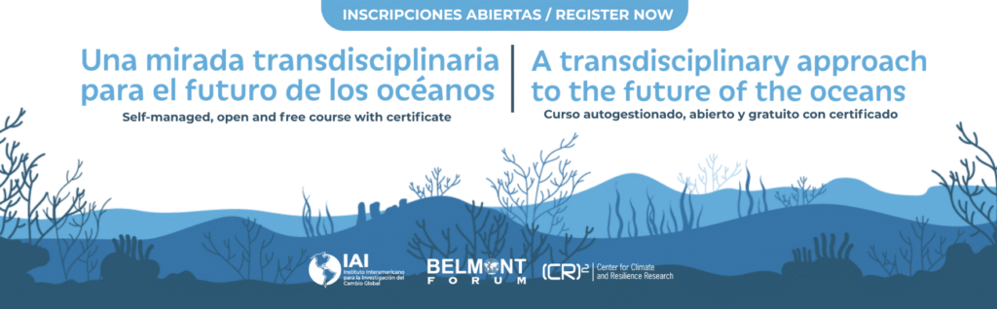

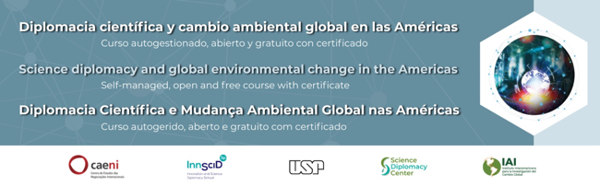
IAI’s Virtual Campus
8 JAN 2026
OFFLINE COURSES
444 registrations
350 registrations
600 registrations

Slide 12

IAI’s Virtual Campus
8 JAN 2026
PILOT COURSE
Modules
Image processing and visualization
Time series analysis
Calculations with vector data
Analysis of changes in land cover
Presentation of before/after changes

Slide 13
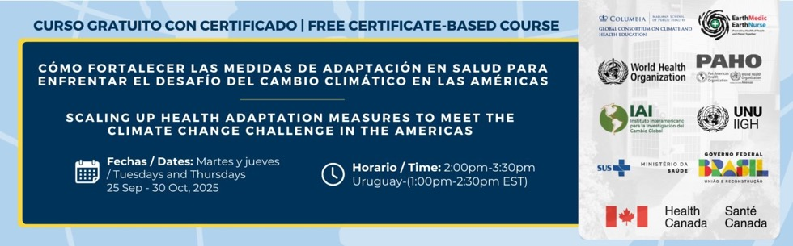
IAI’s Virtual Campus
8 JAN 2026
ONLINE COURSE
+3,000 registrations
4 languages (Spanish, French, Portuguese, English)

